Slide 1
Understanding solvent-induced phase transformations driven by anomalous mass transfer
CMAC Open Days, 15/11/2023
Irene Moreno Flores
Supervisor: Dr Javier Cardona

Slide 2
At a glance
Phase-field models to simulate mass transfer and phase transformations
DataFactory:
Isoniazid in cyclohexane
1

Slide 3
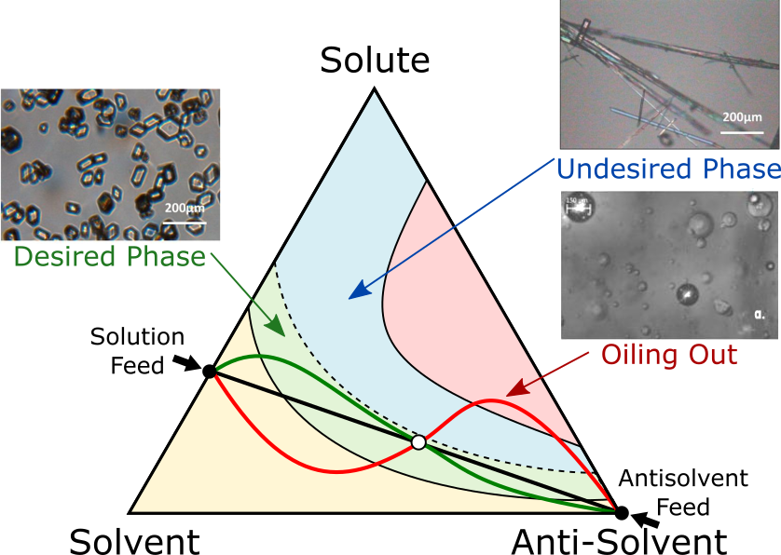
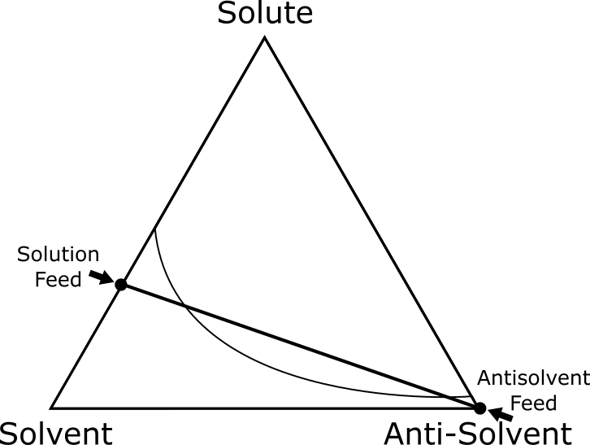
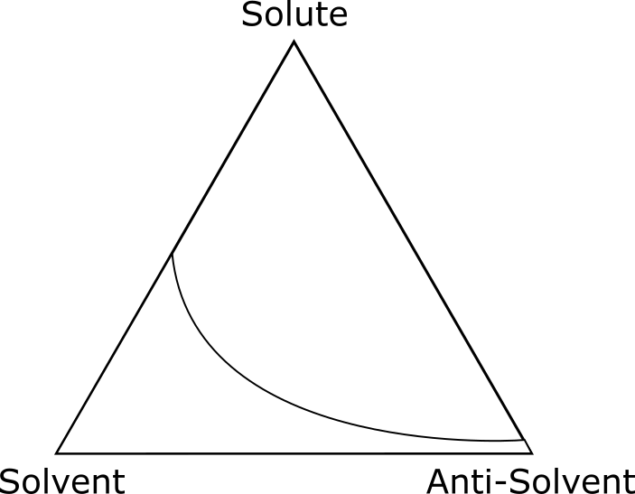
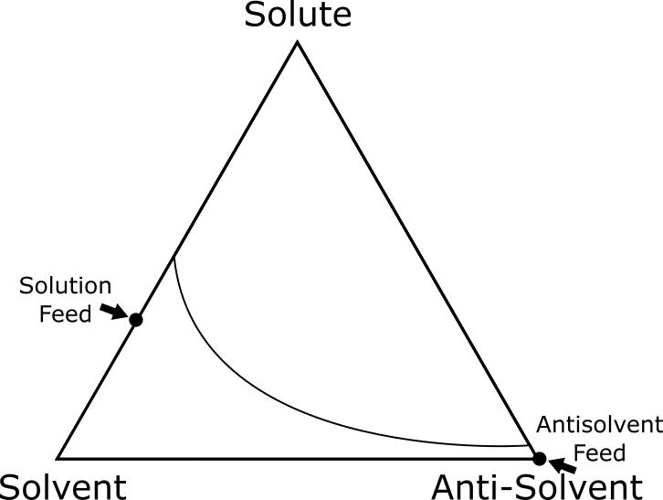
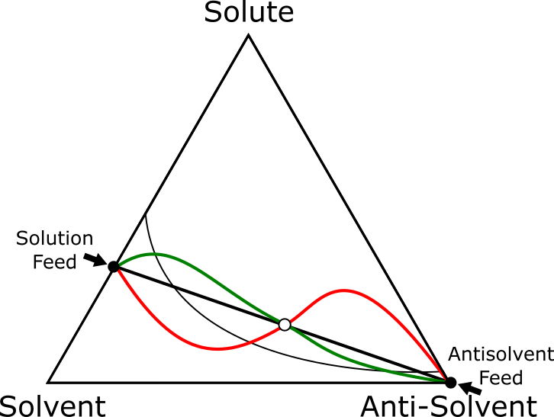
Background and motivation
Gap in fundamental understanding of how mixing processes occur (LLPS, Ouzo effect, uphill diffusion)
Current understanding: mixing process evolves through black line (ideal)
Green line: Desired outcome still achieved
Blue area: Appearance of undesired crystal phase
Red line: The system liquid-liquid phase splits
[1]
Accurate modelling of antisolvent/cooling, seeded/unseeded crystallisation
Aim
[1] Graph created by D. McKechnie
2

Slide 4
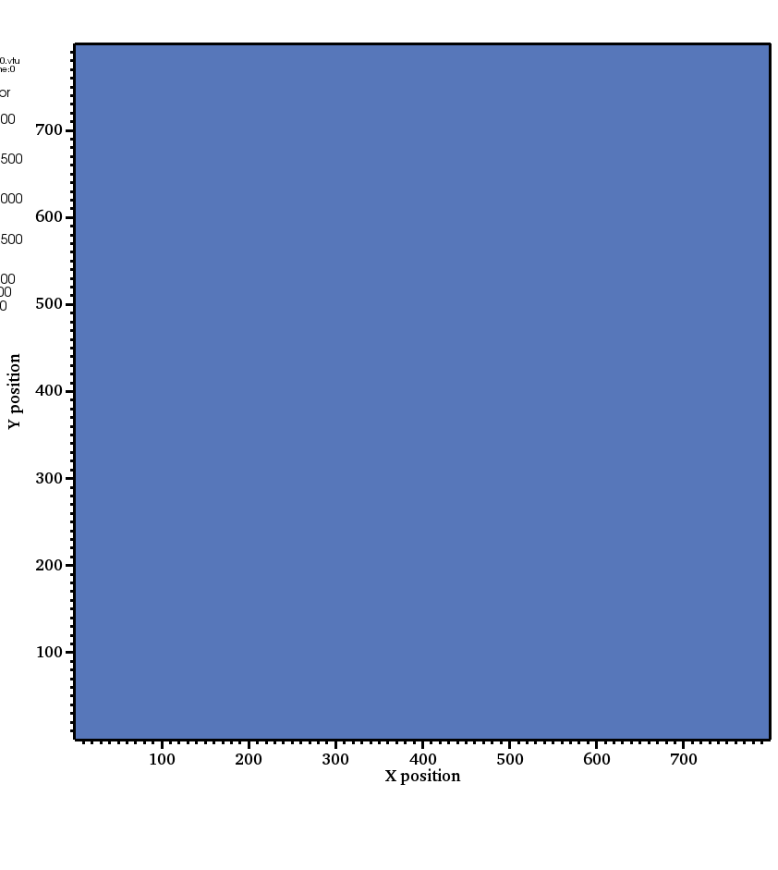
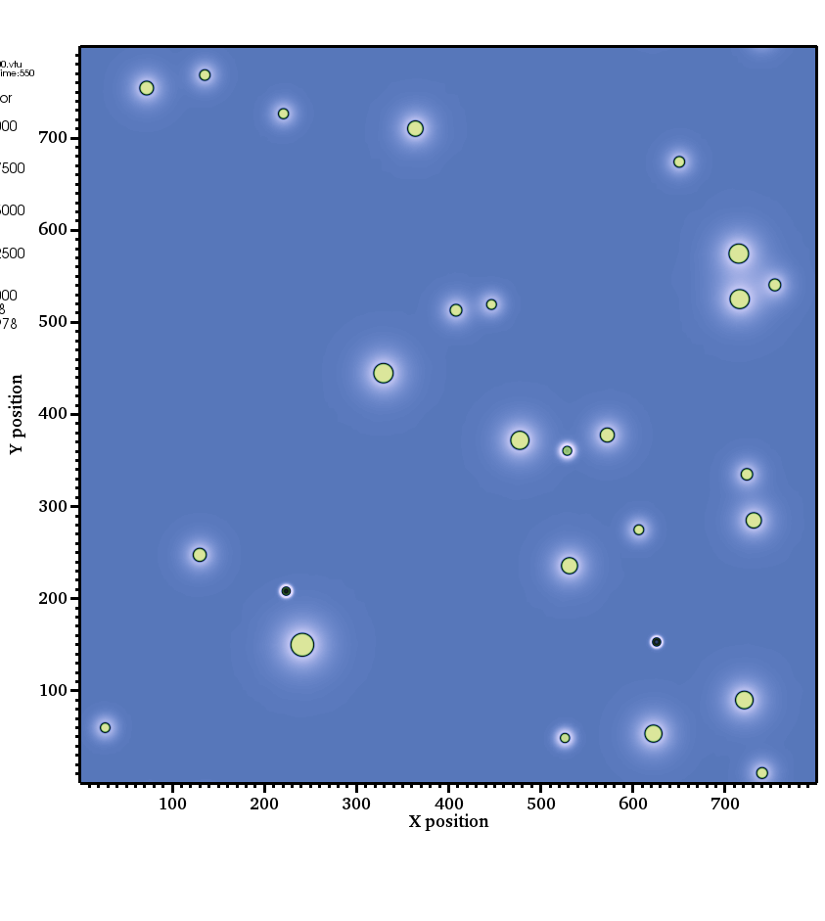
Model comparison
Allen-Cahn dynamics [6]
Diffusion (Fick’s Law)
Cahn-Hilliard dynamics
$$J_{A}={−D}_{AB}c·∇x_{A}$$
c
$$J_{A}=−Đ_{AB}c_{A}·∇βμ_{A}$$
${∂c}/{∂t}=∇\left(M/{f,cc}∙∇μ_{c}\right)$; $μ_{c}=f_{α,c}\left(1−H\right)+f_{β,c}H$
Y position (µm)
Y position (µm)
$$\frac{∂x_{A}}{∂t}+∇(vx_{A})=D_{AB}·∇^{2}x_{A}$$
Y position (µm)
$$\frac{∂x_{A}}{∂t}+∇(vx_{A})=∇\left[Đ_{AB}·∇x_{A}\right]+∇\left[Đ_{AB}x_{A}·∇\left[A{\left(1−x_{A}\right)}^{2}−ε^{2}∇^{2}x_{A}\right]\right]$$
${∂η}/{∂t}=−Lμ_{η}$; $μ_{η}=\left[f_{β}−f_{α}−\left(c_{β}−c_{α}\right)f_{β,c_{β}}\right]H+Wf_{Land}−κη$
X position (µm)
X position (µm)
X position (µm)
Spinodal
1 phase
Binodal
time
3

Slide 5
Results
Come to my poster
49
4

