Slide 1
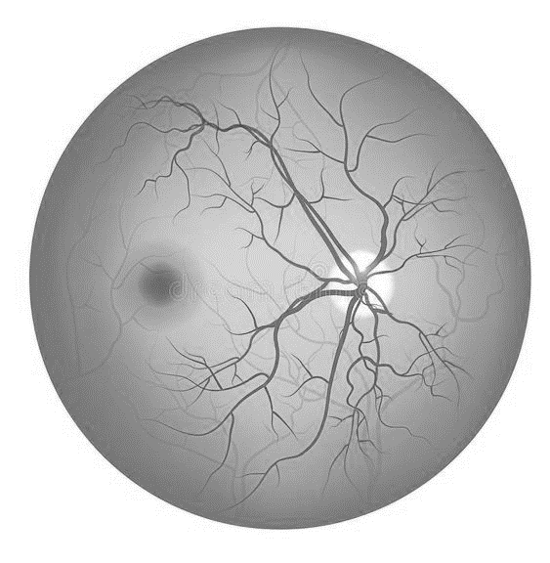
Smartphone-based Retinal Imager for Self-Monitoring of Diabetic Retinopathy
X THE PLACE OF USEFUL LEARNING
Keely Shand¹, Jamie Thomson², Sam Philip³, Jan Boers², Mario Ettore Giardini¹
¹ University of Strathclyde, Glasgow
² IDCP Scotland Ltd
³ NHS Grampian & University of Aberdeen
Funded by: University of Strathclyde (SRSS REA programme) and IDCP Scotland Ltd.
Notes:
-name
-title
- funders

Slide 2
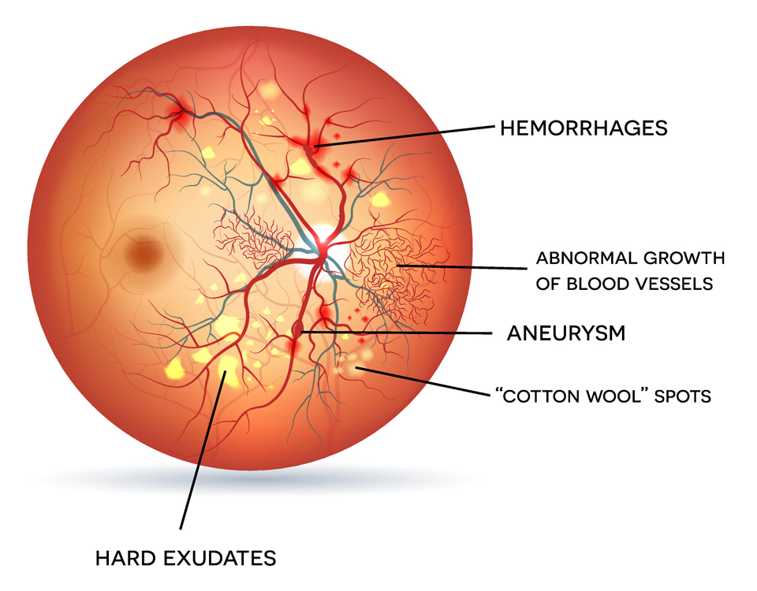
Diabetic Retinopathy
Fig 1. Healthy Retina (left) and Retina with Diabetic Retinopathy (right). Adapted from Diabetic retinopathy stock illustration by TefiM, 2017, iStock. Retrieved from https://www.istockphoto.com/vector/diabetic-retinopathy-gm653408680-118803049.
Notes:
-422 million people live with diabetes
- all a risk of complication DR
- if left undiagnosed and un treated – can cause irreversible vision loss

Slide 3
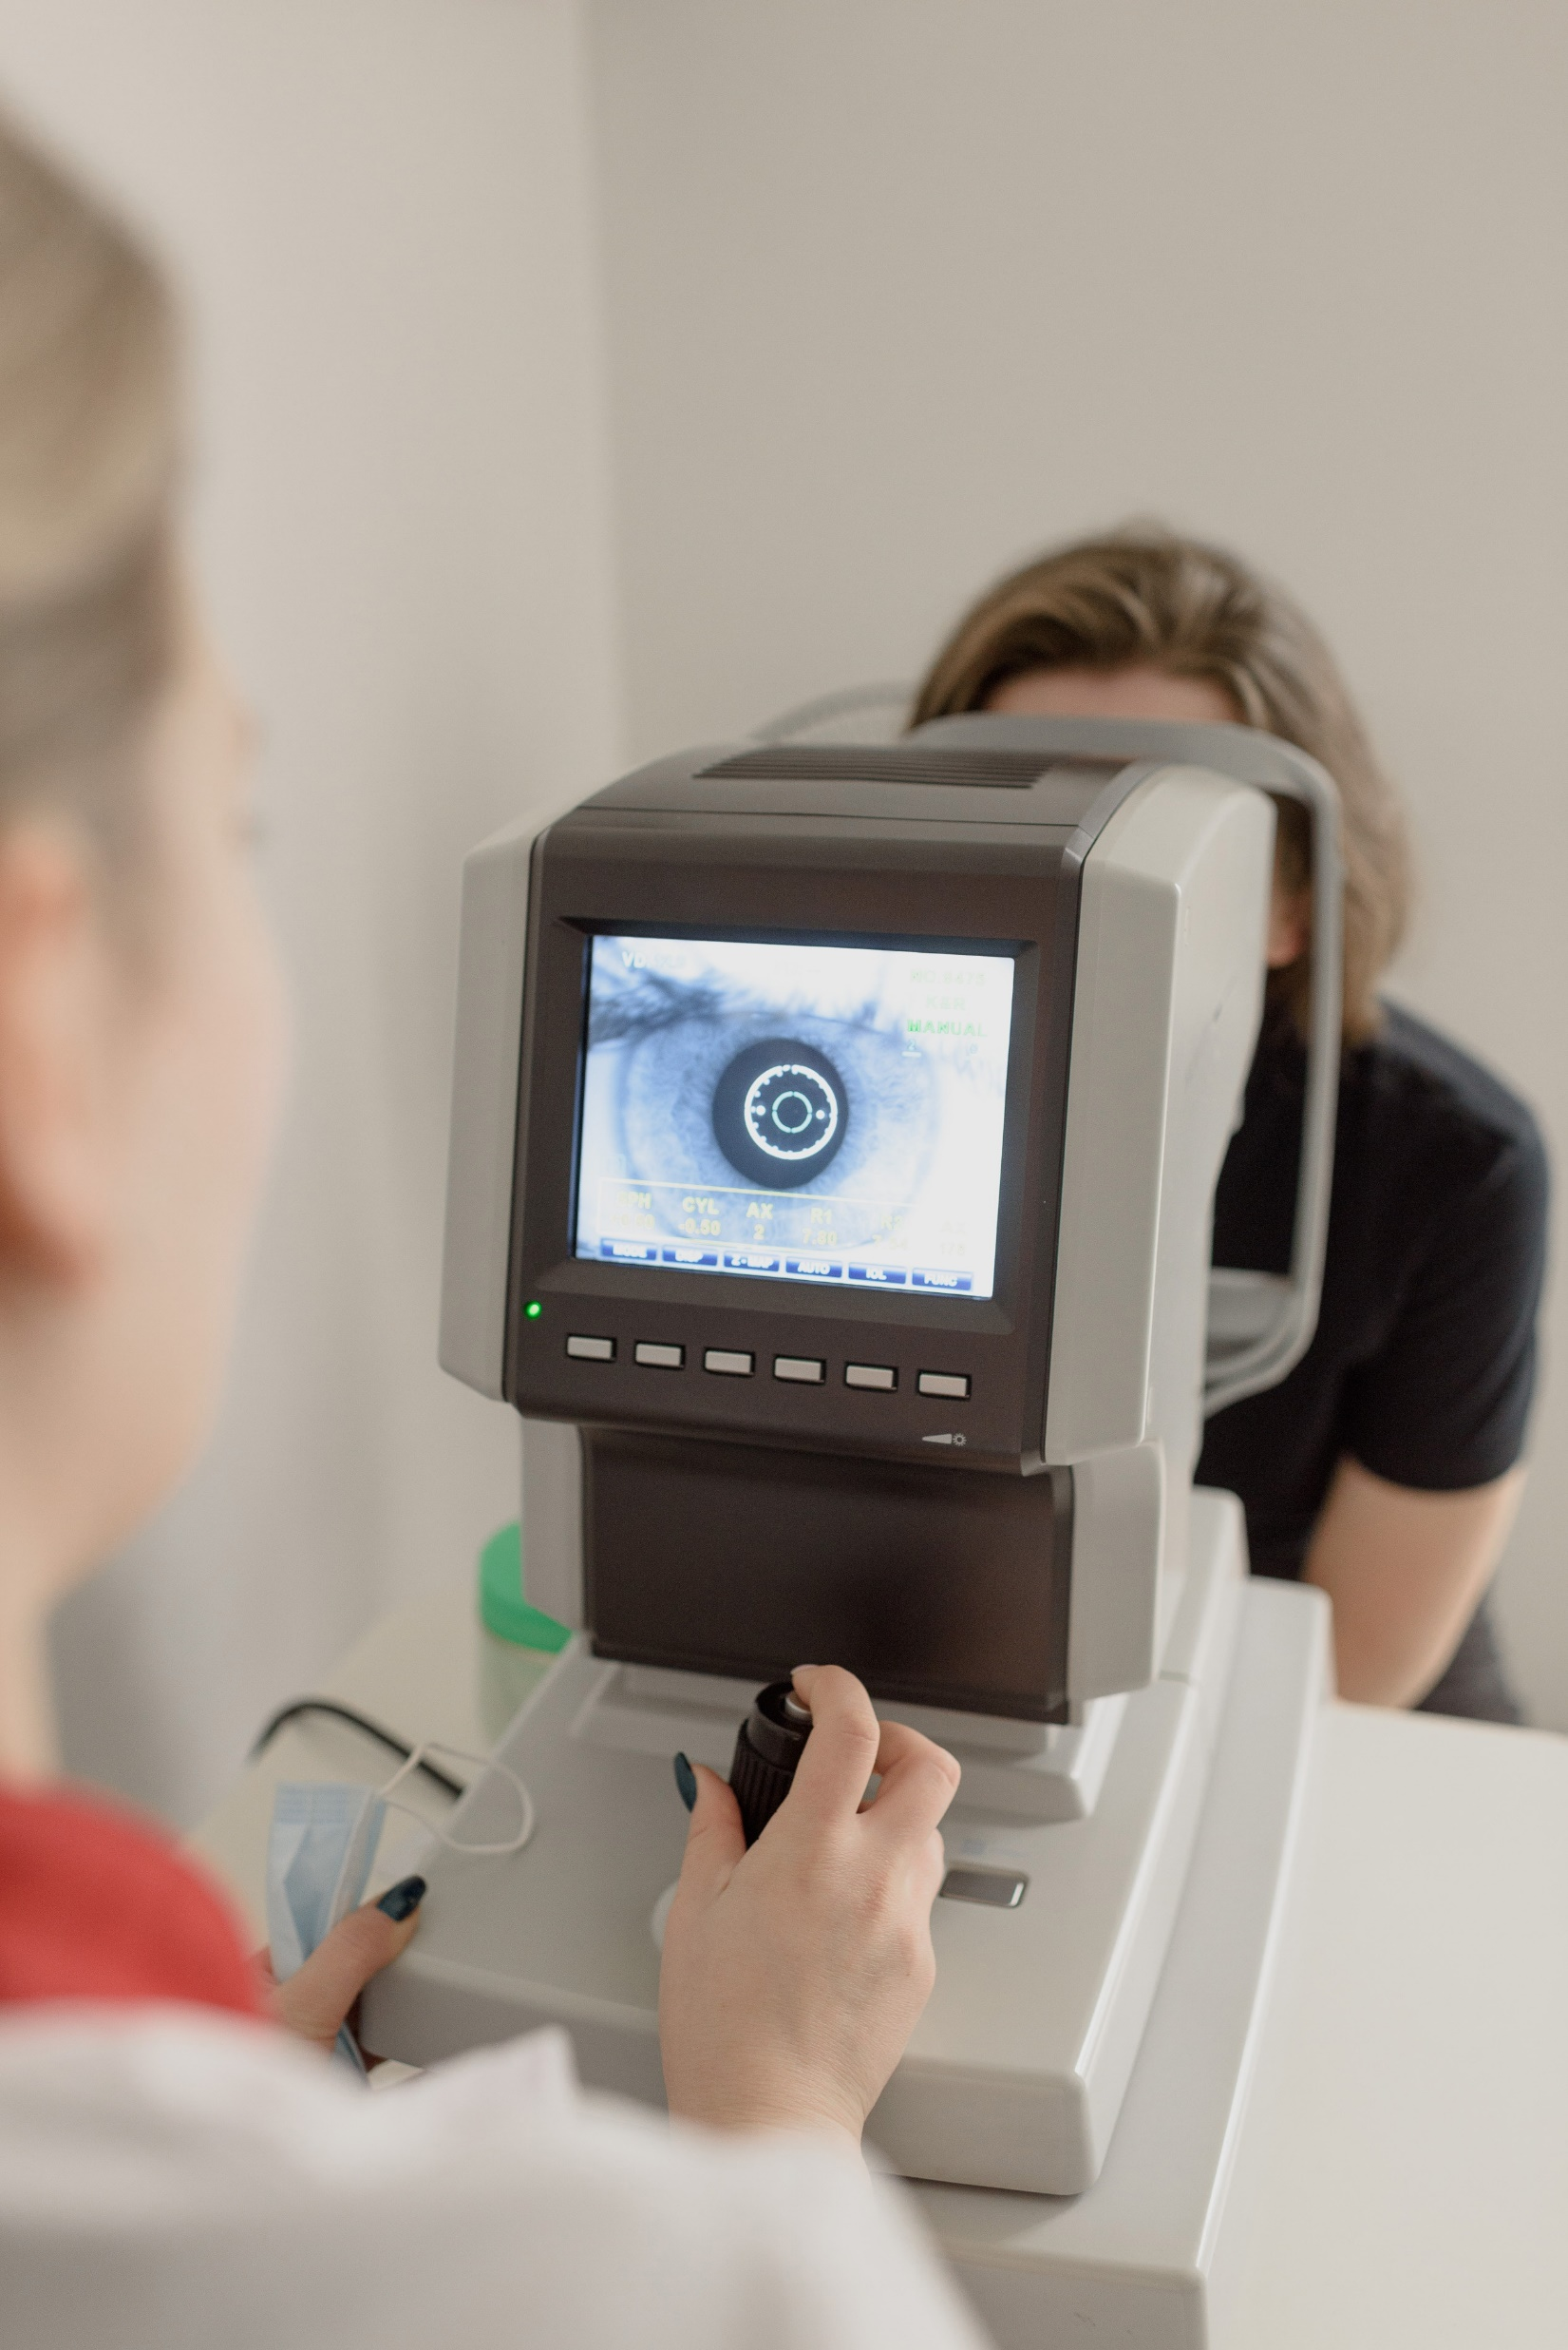
Screening Compliance is LOW
Bulky
&
Expensive
Fig 2. Screening for Diabetic Retinopathy using a fundus camera. Adapted from Retinal exam stock photo by propeller, 2014, iStock. Retrieved from https://www.istockphoto.com/photo/retinal-exam-gm513445279-47247118?phrase=fundus+camera.
Notes:
- regular screenings
- using a fundus camera
- compliance is low
- due to the inconvenience
- work is going into address this bring the screening closer to home
- but fundus cameras are v bulky and expensive

Slide 4
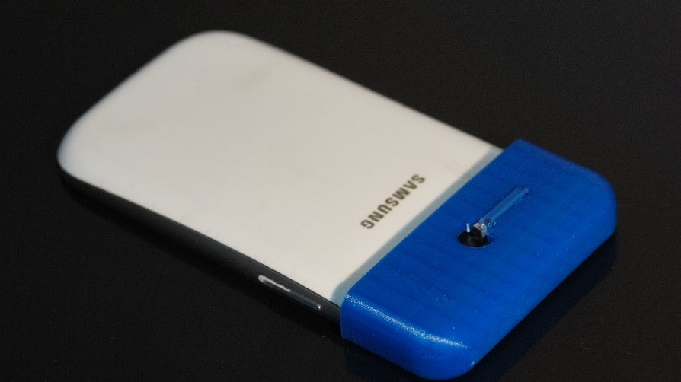
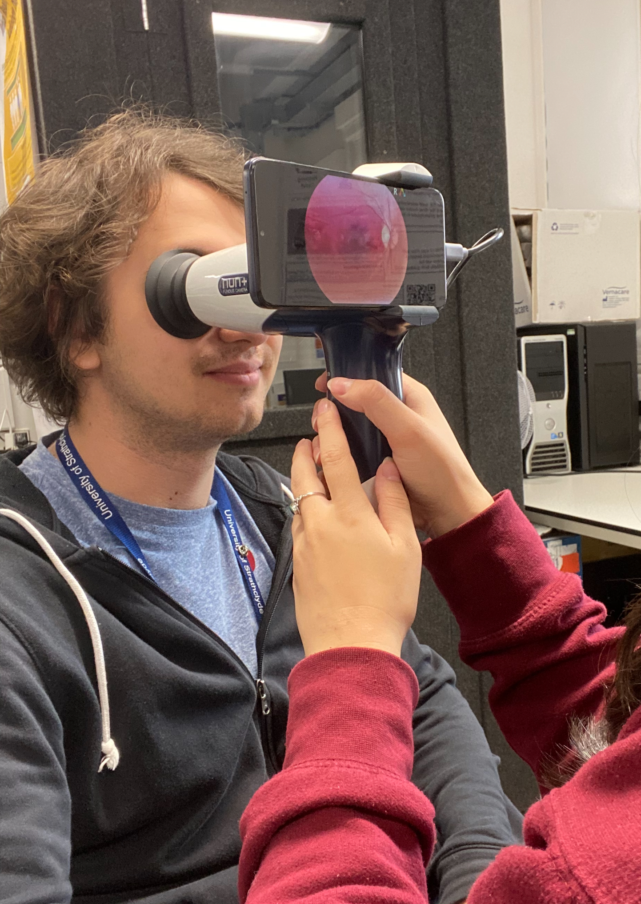
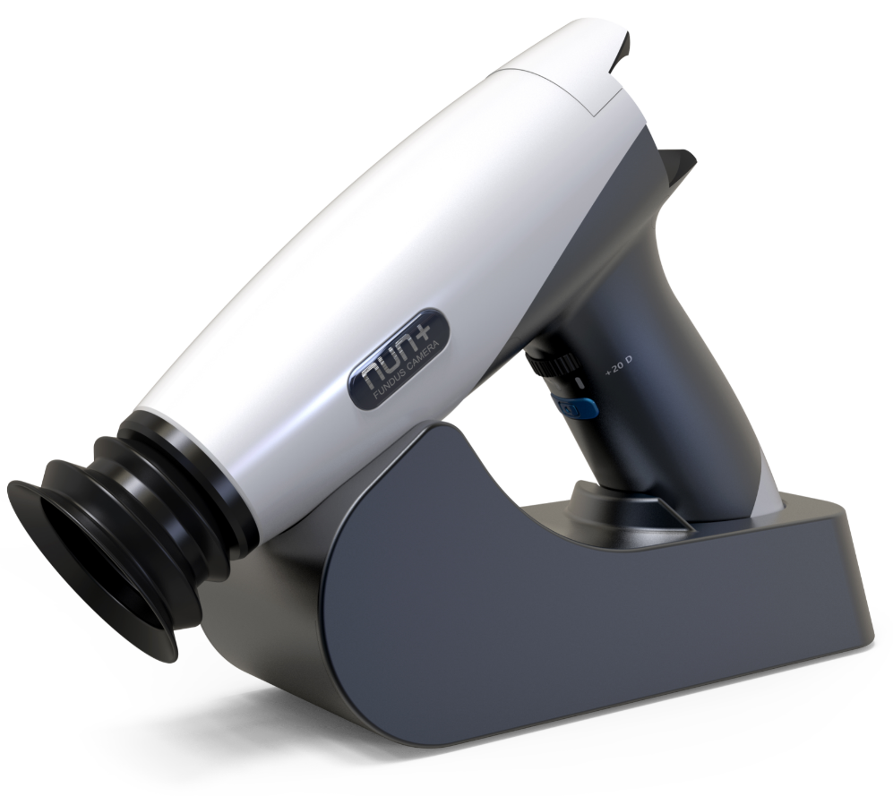
Fig 4. Peek Vision Smartphone-based retinal Imager
Fig 5. Nun+ Smartphone-based retinal Imager
Fig 6. Nun+ being used to take a Retinal Image, requires an operator.
Notes:
-therefore research has gone into developing portable fundus camera or retina imagers
With many do this by creating adapters for smartphones
- however these still require a skilled operator to take the images

Slide 5
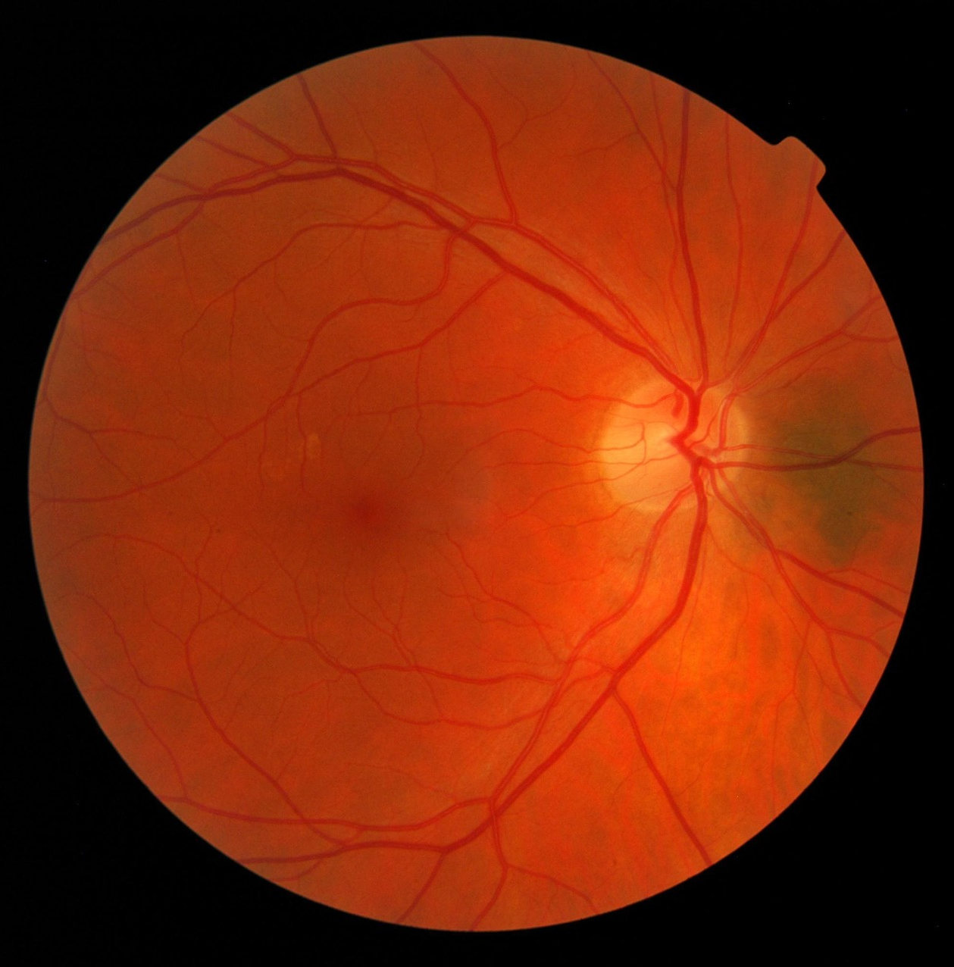
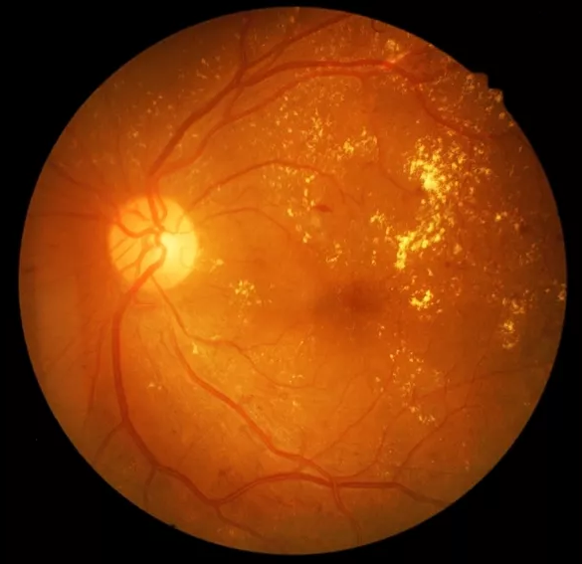
Aim
Create a novel smartphone-based retinal imager specifically for self-imaging.
Fig 7. Retinal Image of Diabetic Retinopathy. Adapted from Retina of diabetic - diabetic retinophaty stock photo by memorisz, 2014, iStock. Retrieved from https://www.istockphoto.com/photo/retina-of-diabetic-diabetic-retinophaty-gm509686269-45975672?phrase=diabetic+retinopathy&searchscope=image%2Cfilm.

Slide 6
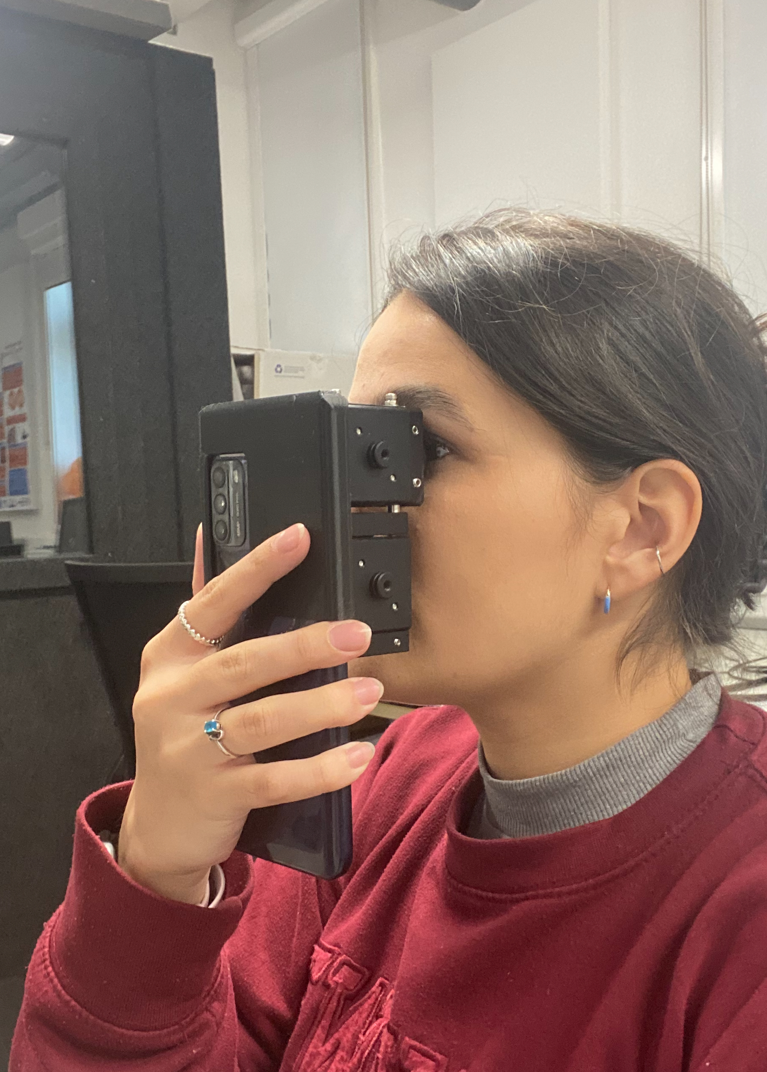
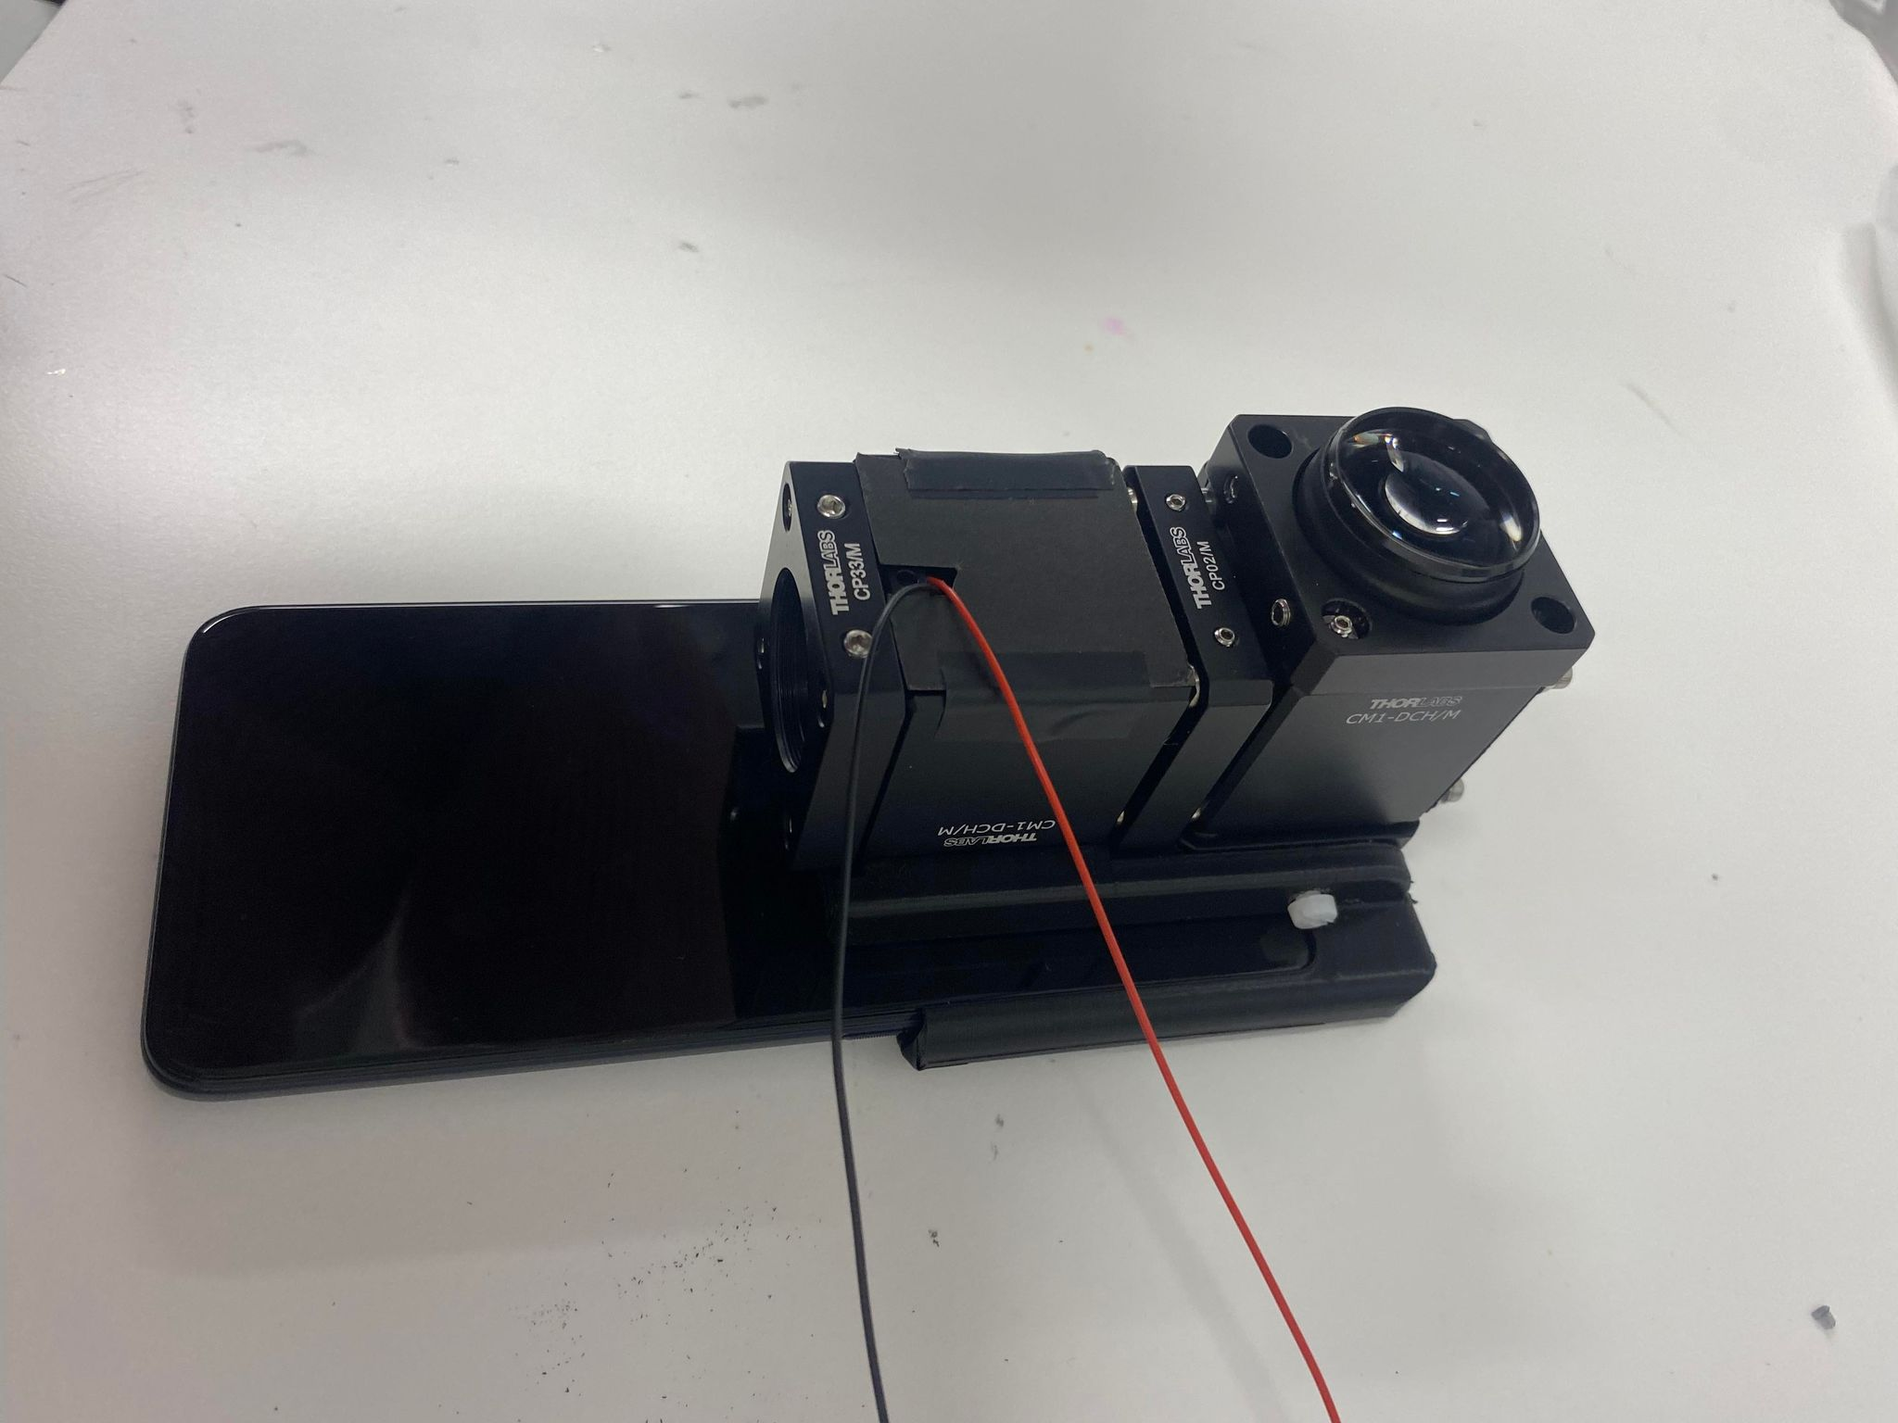
Fig 8. Self-Operated Retina Imager being used by the subject.
Fig 9. Self-Operated Retina Imager using a Motorola G50.
Notes:
- device is a adapter for a Motorola g50
The imaging, fixation and illumination of the system is all co-axial
- the imaging system minics a indirect ophthalmoscope using the phone’s front facing camera to capture the image
- a fixation system allows the patient to self-align thei eye to the camera
- it is compact and easy to assemble

Slide 7
Without illumination
With illumination
Fig 10. Images taken with the self-operated retinal imager on a translucent eye phantom A) without the illumination system B) with the illumination system
Notes:
- images using a translucent eye phantom
- are In focus and evently illuminated
- key landmarkds can be seen
- rejection of reflection landmarks underway, which we think is cornealback reflection
- we are currently redigning to address this
- subjectively, the fixation system is effect, with the fixation points beind clearly identifiable

Slide 8
Increase Rate of Diabetic Retinopathy Screening
Self-Operated, Retinal Imaging
Decrease the Risk of Irreversible Blindness
Notes:
As we continue redesigning the device we aim to create
This will allow patients to perform a basic screening at home,
Which will allow us diagnose DR at its earlier stages and in turn….

Slide 9
X THE PLACE OF USEFUL LEARNING

