Slide 1
Embedding the research method within information science practice: approaches to PhD level research in the workplace
George Macgregor ^{a,} ^{b}
ª Scholarly Publications & Research Data (SPRD), IS Information Management, University of Strathclyde ^{b} iSchool, Department of Computer & Information Sciences, University of Strathclyde
https://purl.org/g3om4c | @g3om4c | 0000-0002-8482-3973
Thursday 10 Dec 2020

Slide 2
Introduction…
Contextualising information science research within practice
Importance in plugging gaps that academia does not see
Strategic thinking about research in the workplace
Maturity models for practitioner research
Developing a ‘permanent research’ philosophy
Considering formal routes to PhD level work
Relativism!

Slide 3
Research in the workplace
Workplace creativity a key driver of organizational innovation, novelty and achievement
‘Employee-driven innovation’ (EDI) [1]
Informing organizational decision making
Building knowledge capacity (the knowledge org.)
Fallacy of ‘scientific knowledge’ in the workplace [5]
Practitioner as mere ‘consumer of scientific knowledge’ promulgated by academia
Failure of academia to address real practitioner problems
Overestimation of the applicability of academic research in practitioner contexts [4]
Communication breakdown?! Semantic drifting?! Research-to-practice disconnection?!

Slide 4
Research maturity needed
Problems at the academic side of research; but…
Need for research maturity in workplace:
Randomness of day-to-day practitioner problem-solving
Lack of documentation in approaches or analysis
Lack of formal approaches adopted
Press <pause> --- <Breathe deeply> !
Switch to strategic, planned, deliberate approaches

Slide 5
Research in workplace: a maturity model
Commitment to research approaches to understand, innovate & inform decision making. Communication of findings to internal & external audiences. Evidence of behavioural changes arising from findings.
Research philosophy (state of ‘permanent research’) embedded within professional practice. Efficacy displayed in the research lifecycle. Strategic use of research to influence organizational priorities & inform communities of practice.
Defining research needs of workplace; introducing systematic & knowledge-based approaches to undertake & communicate research internally.
Unaware of research impact in workplace; research unincorporated into practice.
Reacting to workplace research needs in ad hoc manner; chaotic, anecdotal approaches deployed. Dependence on prior knowledge and experience.
Mature:
Embedded – or state of ‘permanent research’
Committed
‘Maturity models’…
Popular tool in software, IT systems, business
Cropping up elsewhere [3]
Conceptualise or measure IS/ILM research in the workplace
Understanding, NOT undermining
Research of any type useful!
Defined
Reactive
Unaware

Slide 6
‘Permanent research’ philosophy
Adopting permanent research – you don’t need to be a Trotskyist!
Permanent research ≠ Permanent revolution ☺
Holistic approach to research in workplace
Embedding research philosophy into practice & making time
Linking and aligning with organization objectives
Factoring research into project planning
Acceptance that most problems are not as simple as one might think
Striving for superior understanding; decisions based on evidence; persuading and influencing
Or, getting your way?! ;-)
Cultivating research mind-set among colleagues
Career benefits and kudos
Publications…?
Honoré Daumier of the French Revolution of 1848 – CC0

Slide 7
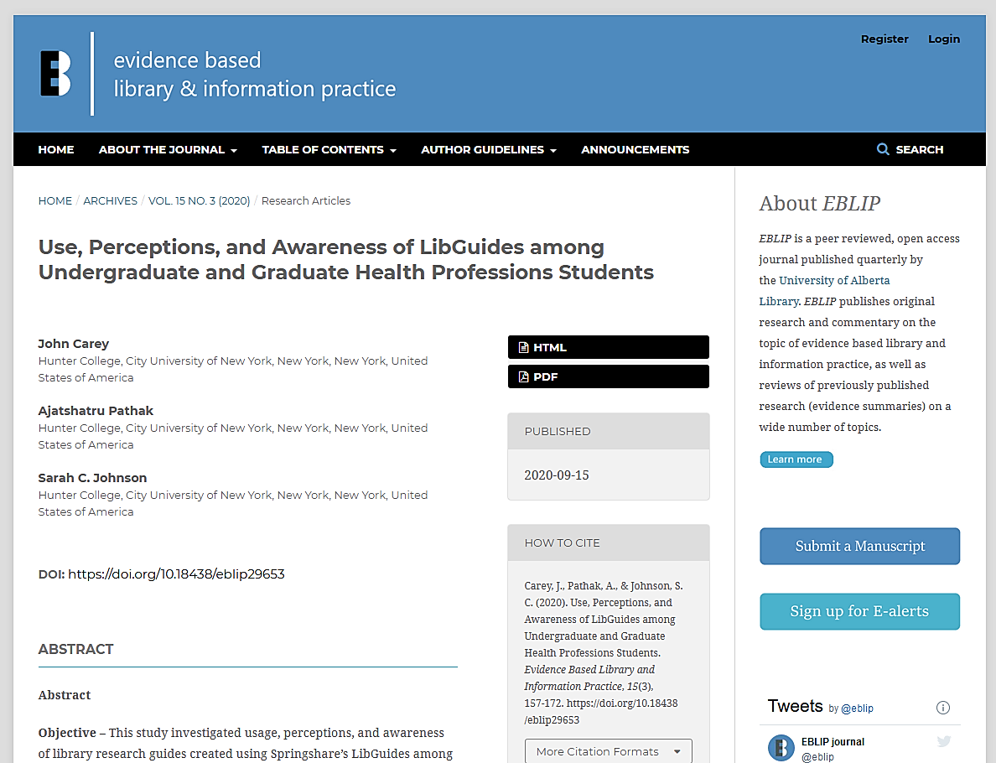
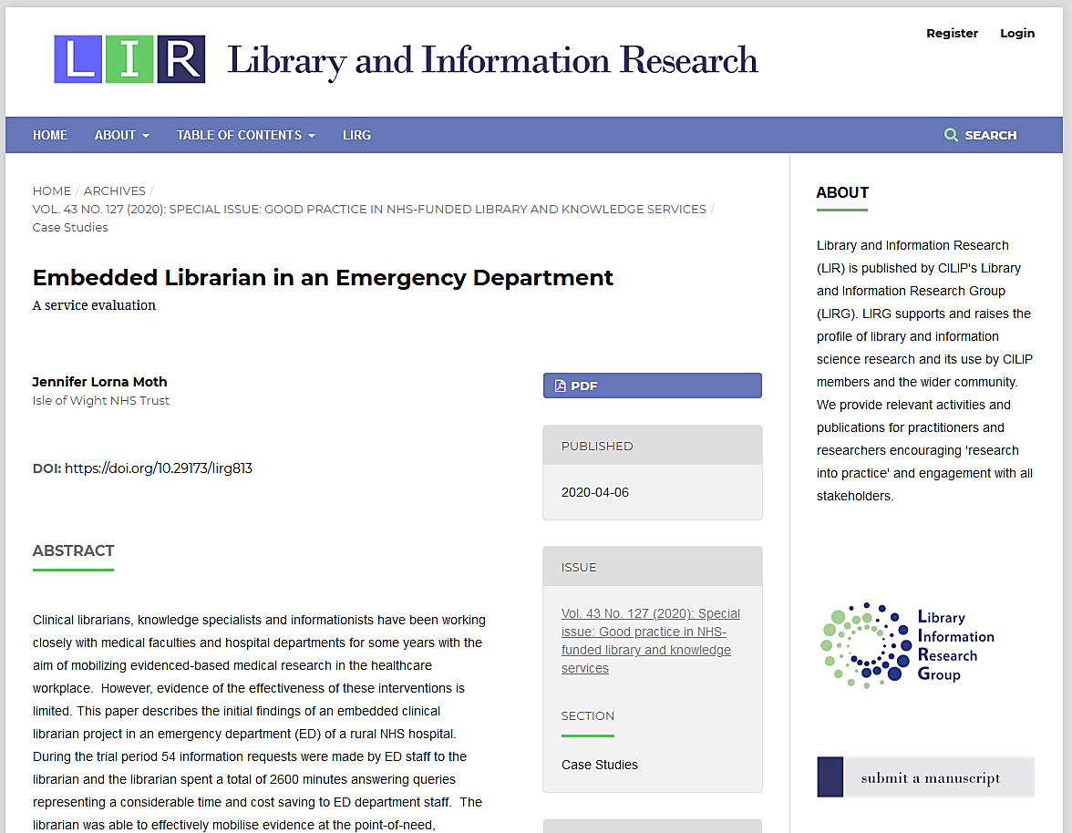
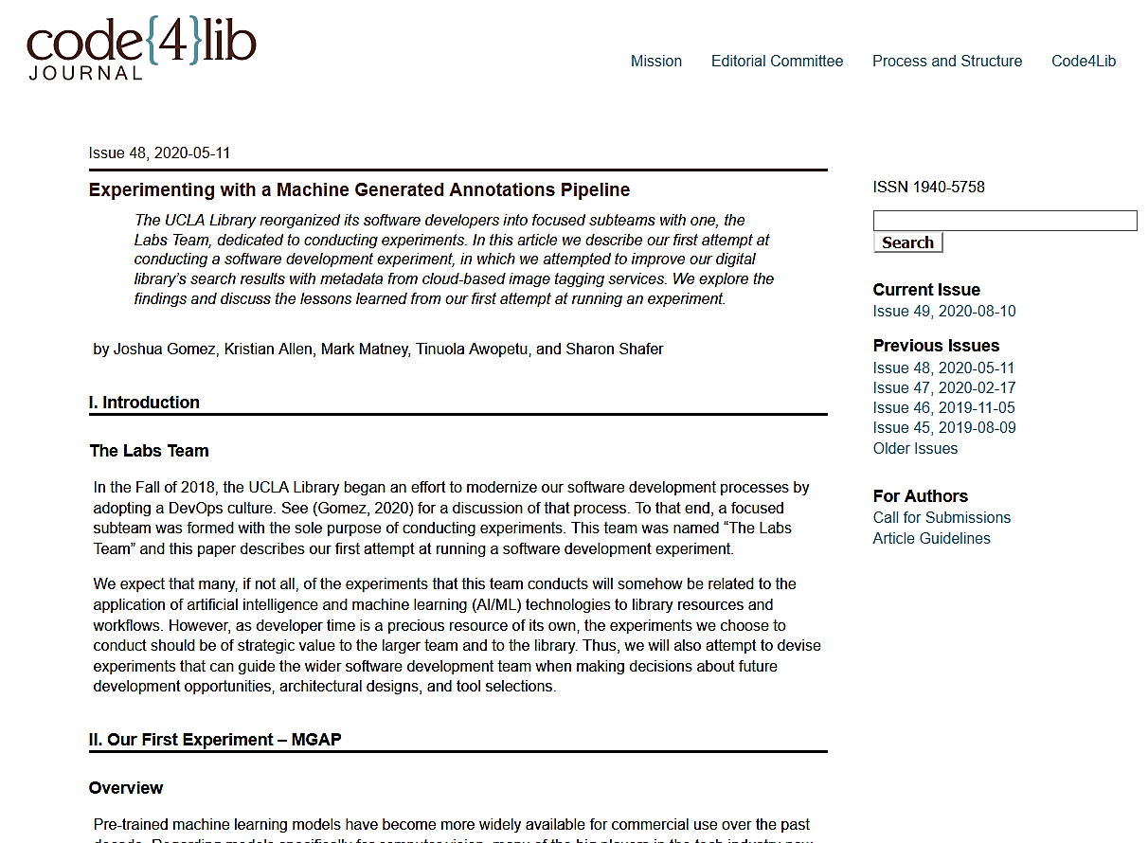
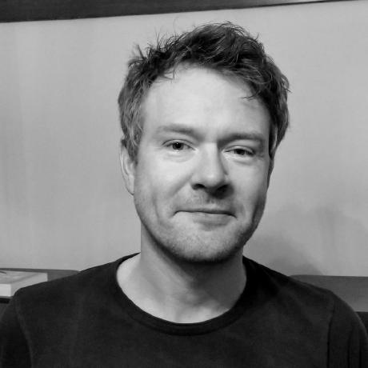
Reflect & question
Reflect on efficacy of any change to current practice or evaluate existing process
Hypothesise! Do we need to improve our understanding of impacts? Locally, externally, or both?
Plan & organize
Plan; adopt a structured research approach
Consider timescales & protracted data collection – also ethics?
Execute
Design & deployment of research instruments – or launching of experiment
Data gathering & analysis – patience may be required here
Communicate
Consult literature, often outside ILM/IS
Which research methods or methodologies? Feasibility?
Resisting temptation to cut corners; rigour!
Research questions?
Remember, breathe!
Consider nature of data & analysis, & management
Preparing for data sharing
To whom should we communicate? Internal, external, or both – or not at all?
Negative findings
Research limitations
Emergence of extensive strand of enquiry?
Selecting journals / conferences
Open scholarship – leading from the front

Slide 8
Harnessing permanent research
Publications
….not forgetting organizational innovation and the broader objectives of the permanent research philosophy
Practice makes perfect!
Influencing practice in the sector
Identifying the research threads
Themes, ongoing research questions, ‘reaching for truth’…
Establishing the trajectory for future research
Observing a coherence in your research….?
Going beyond: the PhD?
Traditional doctorates vs. ???

Slide 9
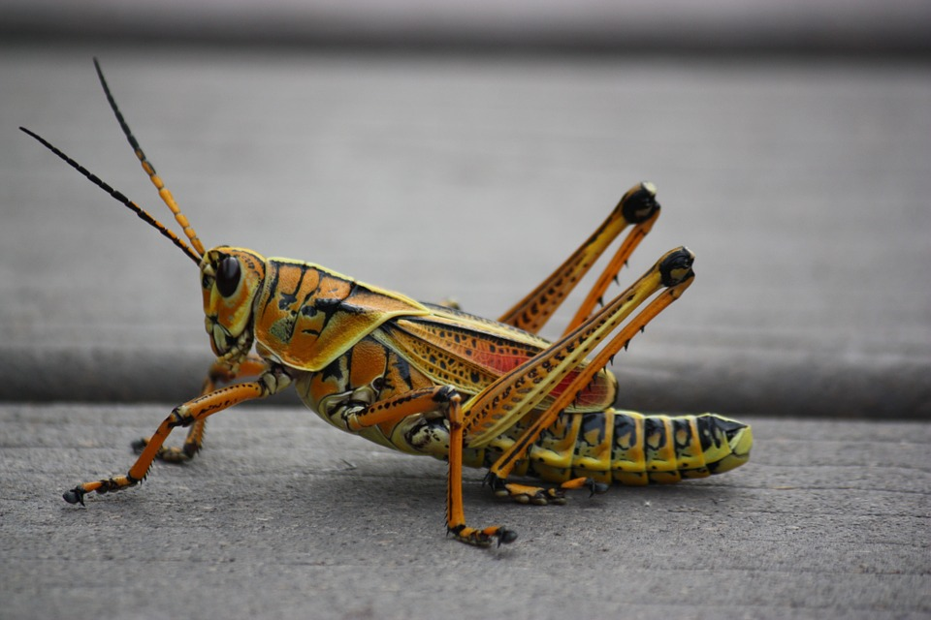
PhD by published works
PhD ‘by publication’
Evolving nature of doctorates
Harnessing those threads and coherence!
Can be a superior approach to PhD level research
Could have planned it that way after all
Take the long view….
But what is it?
Collection of published works, usually with a common theme, accompanied by….
Substantial thesis/critical appraisal (40,000-60,000 words)
Prima-facie (1,000-5,000 words)
Formal thesis submission and a viva voce
Pixabay License

Slide 10
Published works
Contribution to knowledge & impact
Research journey, evolution & reflection
PhD by published works
Research novelty & future research
Critical commentary
Establishing coherence as body of work

Slide 11
PhD: A personal anatomy…
11 assembled works united in exploration of topics surrounding resource discovery
Resource discovery the defining narrative throughout my research career
Works grouped into one of the four resource discovery themes
Selected works charted my personal research ‘journey’
Works selected because they a) best reflected the evolution of my personal research journey, & b) established coherent research narrative
Resource discovery within digital libraries
PW1, PW2, PW3
Resource discovery concepts within KOS & Semantic Web contexts
PW4, PW5, PW6, PW7, PW8
HCI & curriculum design repositories
PW9
Open science: resource discovery & open repositories
PW10, PW11

Slide 12
…but start at the beginning
Pursue a ‘permanent research’ ethos first and foremost
Reflect & question, plan & organize, execute, & communicate
Success can be a barometer of where to go travel to next!

Slide 13
Conclusion
Sector requires more research and greater maturity
Organizationally but also to move the discipline forward – step up to the plate!
Jettison ‘hash bash’, reactive research – plot yourself on the maturity model – and embrace the research method
Embrace a ‘permanent research’ ethos which seeks to align research with organizational or team objectives to earn the gift of time
Consider all change ripe for research and analysis
Look for coherence emerging in research communications and thinking
Evidence of a programme of doctorate level work?

Slide 14
References
[1] Hansen, Kåre, Oscar Amundsen, Tone Merethe Berg Aasen, and Leif Jarle Gressgård. “Management Practices for Promoting Employee-Driven Innovation.” In Workplace Innovation: Theory, Research and Practice, edited by Peter Oeij, Diana Rus, and Frank D. Pot, 321–38. Aligning Perspectives on Health, Safety and Well-Being. Cham: Springer International Publishing, 2017. https://doi.org/10.1007/978-3-319-56333-6_19.
[2] Oeij, Peter R. A., and Steven Dhondt. “Theoretical Approaches Supporting Workplace Innovation.” In Workplace Innovation: Theory, Research and Practice, edited by Peter Oeij, Diana Rus, and Frank D. Pot, 63–78. Aligning Perspectives on Health, Safety and Well-Being. Cham: Springer International Publishing, 2017. https://doi.org/10.1007/978-3-319-56333-6_5.
[3] Stahl, Bernd Carsten, Michael Obach, Emad Yaghmaei, Veikko Ikonen, Kate Chatfield, and Alexander Brem. “The Responsible Research and Innovation (RRI) Maturity Model: Linking Theory and Practice.” Sustainability 9, no. 6 (June 2017): 1036. https://doi.org/10.3390/su9061036.
[4] Haddow, Gaby, and Jane E. Klobas. “Communication of Research to Practice in Library and Information Science: Closing the Gap.” Library & Information Science Research 26, no. 1 (December 1, 2004): 29–43. https://doi.org/10.1016/j.lisr.2003.11.010.
[5] Roberts, Alasdair. “The Importance of Workplace Research.” Public Administration Quarterly 17, no. 2 (1993): 201–26.

Slide 15
X THE PLACE OF USEFUL LEARNING

