Slide 1
'Transformative' deals with publishers: a controversial step forward in the implementation of Open Access
Pablo de Castro
euroCRIS Secretary
Open Access Advocacy Librarian
University of Strathclyde
pablo.de-castro@strath.ac.uk
http://orcid.org/0000-0001-6300-1033

Slide 2
Speaker’s academic affiliation
University of Strathclyde Glasgow
Founded 1796 as “the place for useful learning”
22,295 FTE Students and 3,200 staff (2017/18)
Research: research grants and contracts income of £65.6m in 2017*
Among the 20 top research-intensive universities in the UK
* 14.5% increase from previous year and an overall increase of over 60% over a six year period

Slide 3
Speaker’s academic affiliation
Co-lead (w/ TIB Hannover) for Open Access WG of CESAER TFOS
Association of over 50 European Universities of Science and Technology
Several TU9 institutions are CESAER members, some represented in its Open Access Working Group
Secretary for the euroCRIS Association
Dutch non-profit founded 2002
Association of professionals and bodies worldwide in the areas of research information management and CRIS systems
Custodian for the Common European Research Information Format (CERIF)
MoUs with various relevant organisations in the RIM field: OpenAIRE, ORCID, COAR...

Slide 4
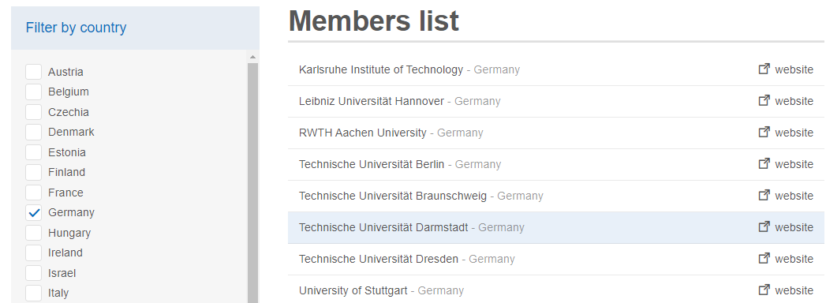
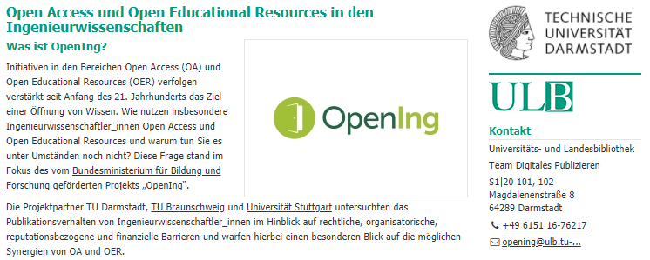
German member institutions of CESAER include several TU9 members. Uni Stuttgart , RWTH Aachen and TIB/Leibniz Uni Hannover represented (together with ETHZ in the CH and TU Wien in AT) in the OA WG of CESAER’s Task Force for Open Science
The CESAER OA WG conducted some level of collaboration with the BMBF-funded OpenIng project led by TU Darmstadt – both initiatives being devoted to exploring the specifics of Open Access implementation in the Engineering disciplines

Slide 5
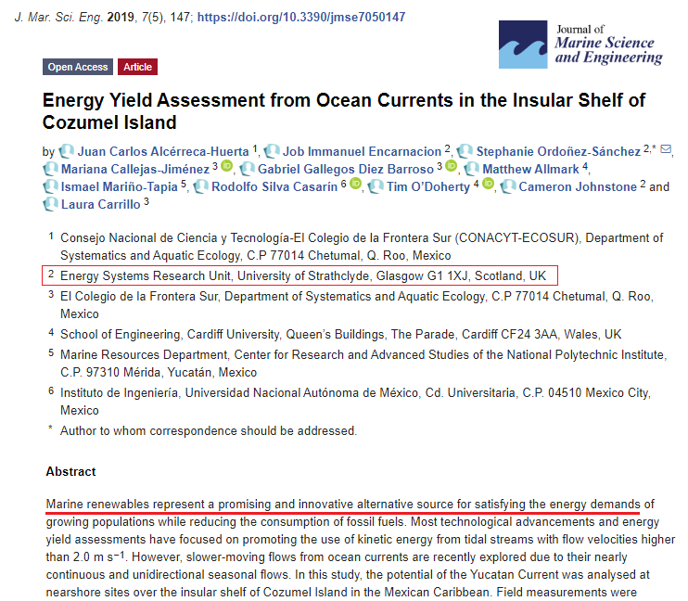
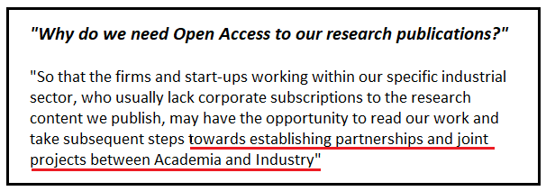
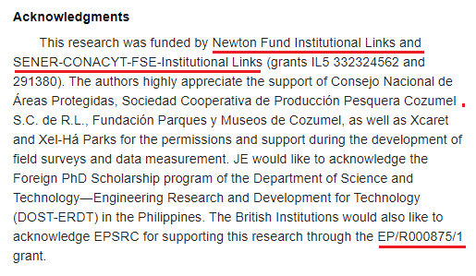
Open Access and innovation: a British (& all-European) approach

Slide 6
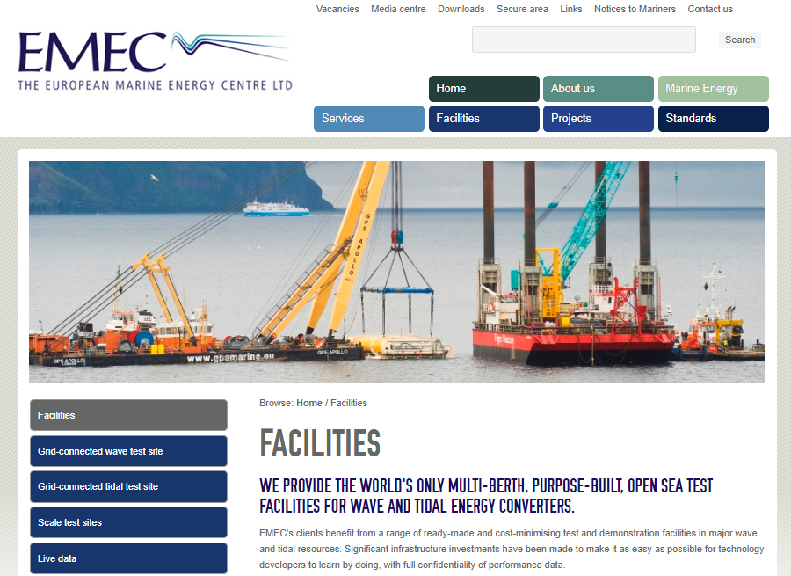
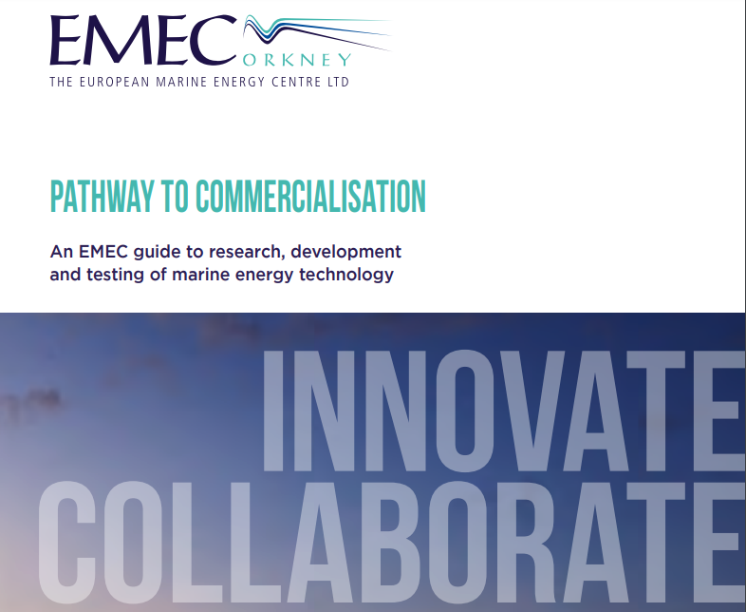
European Marine Energy Centre (EMEC), Orkney, Scotland
http://www.emec.org.uk/?wpfb_dl=188

Slide 7
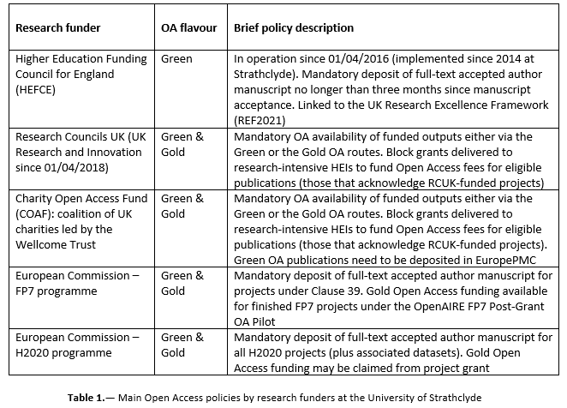
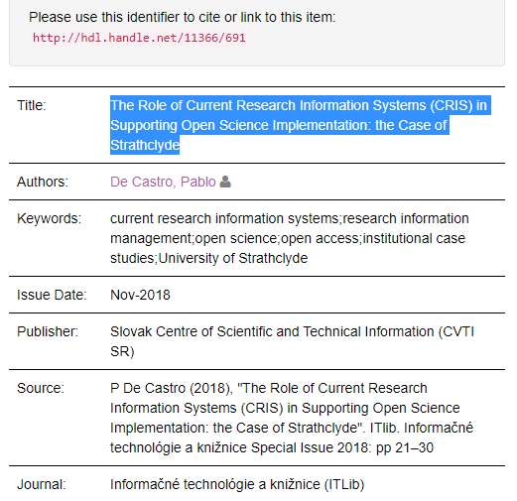
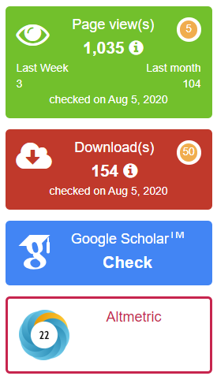
Open Access in the UK: Green & Gold OA

Slide 8
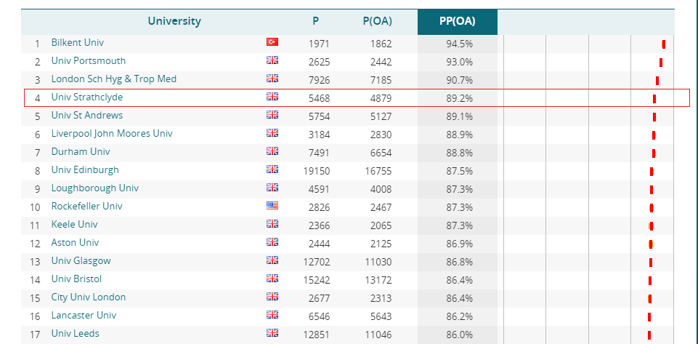
OA ranking – CWTS Leiden 2020

Slide 9
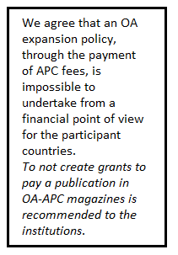
“Controversial”
http://reuniondeconsorcios.conricyt.mx/index.php/primera-reunion/declaraciones/?lang=en

Slide 10
What should “transformative” actually mean?
Officially: to “flip” titles from a hybrid to a pure Open Access model (too early to tell if the cOAlition S proposal will work but guidance is being provided)
Specifically for an institutional Open Access advocate: to be able to offer ECRs a choice not to be forced to wait until the end of an embargo period of up to 24 months (SSH) to openly share their research findings regardless of whether or not their accepted manuscript carry external funding ackonowledgements
So – couldn’t they publish elsewhere, these ECRs? (“Why should we carry the weight of the publishing transition on our shoulders potentially damaging our prospects to build a successful research career for ourselves?")
The DORA Declaration, the Leiden Manifesto and the general drive to leave behind the JIF are all great, but will not see short-term consolidation. Plan S is a pragmatic attempt at fixing the issue in the short-term

Slide 11
A few relevant divides: (v busy) institutional researcher engagement vs (v vocal) ideology
The analysis of the Open Access funding landscape needs to be conducted bearing the institutional publishing landscape well in mind – this is not being properly done and it’s also completely at odds with the usual generalisations

Slide 12
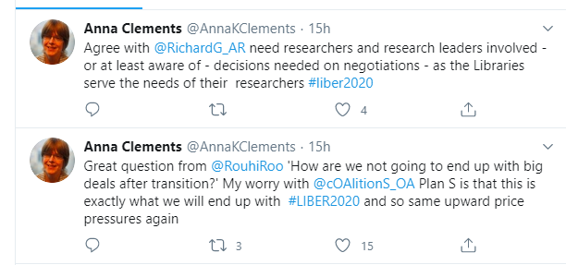
A second v relevant divide: STM vs SSH
Where do researchers want to publish? Can they be persuaded to behave more accordingly with the institutional interest? (meaning the library’s interest, which is a tricky one on its own)
How many researchers are attending Open Access events? Are we perhaps witnessing a significant echo-chamber here?
How many researchers are attending publisher-led sessions at their own institutions, being often urged to attend by their own faculty librarians?
Most initiatives for developing Academia-led publishing infrastructure are SSH – same as most library professionals are SSH
"Build it and they will come”? Open Research Europe

Slide 13
A third divide: language
Most foreign advocates for "the Latin American [non-APC] way" do not speak Spanish/Portuguese or know the actual state of the scholarly comms infrastructure in the region other than the (commendable) non-APC Gold OA initiative SciELO
“[APCs] Not a sustainable business model in Latin America"? https://investigacion.usil.edu.pe/financiamiento-investigacion/pago-apc/
"ACS partners with University of Campinas in first open access agreement in Latin America"

Slide 14
A fourth divide: Global North vs Global South
Homework is not being done: it's not just that LatAm institutions have funding for APCs but that far more APCs are directly being paid by researchers from their grants – they know why they want this. Neither institutions nor consortia or (esp) OA advocates are tracking these payments → OpenAPC promotion remains paramount
The (painful) SCOAP3 funding landscape: free-riding?
It's not reasonable to ask advanced research landscapes to stop exploring models to reach full OA just because their approach may not be applicable everywhere. A mix of models may work better. Wealthy institutions will offer these deals to their researchers regardless of what region they're based in

Slide 15
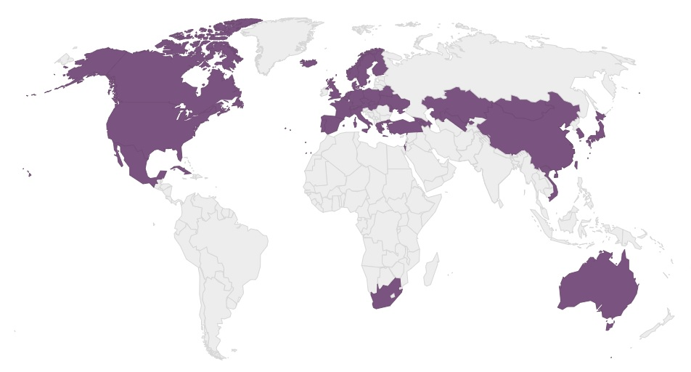
SCOAP3 funding landscape

Slide 16
The actual point of TAs…
… is to promote competition among publishers, bringing some market-driven behaviour into what’s basically an oligopoly
If researchers can be made aware that by submitting to the right titles (those covered by TAs) they can get their papers published Gold Open Access at no cost for them, they’re likely to listen. A thorough (and sorely missing) researcher engagement activity needs to take place in order to ensure this can happen
TAs are indeed benefitting some of the usual suspects, but not all of them. There’s an element of competition being introduced (at least in the UK and for the time being) that may help shift the OA landscape
The work required to test this approach is as hard as that devoted to the implementation of the Green OA HEFCE/REF policy. Very few institutions are actually aware of the implications of this in terms of balance of work across sub-teams. Without this effort, TAs risk becoming a missed opportunity

Slide 17
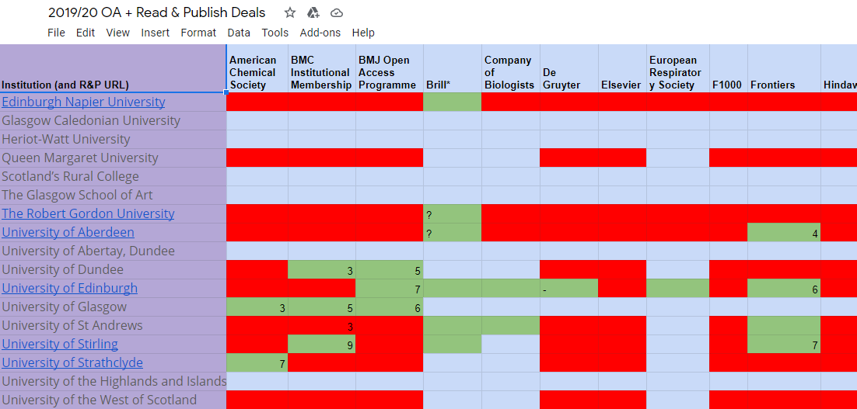
Cross-institutional collaboration around TAs in Scotland

Slide 18
Danke!
Pablo de Castro
euroCRIS Secretary
Open Access Advocacy Librarian
University of Strathclyde
pablo.de-castro@strath.ac.uk
http://orcid.org/0000-0001-6300-1033

