Slide 1

An Experimental and CFD Study of the Extreme Waves Impact on OC3-Hywind Spar Floating Offshore Wind Turbine
Partnership for Research In Marine Renewable Energy
7th PRIMaRE Conference
7-8 July 2020
Yang Zhou, Saishuai Dai, Sandy Day, Qing Xiao, Michael Coppini
Department of Naval Architecture, Ocean and Marine Engineering
University of Strathclyde

Slide 2
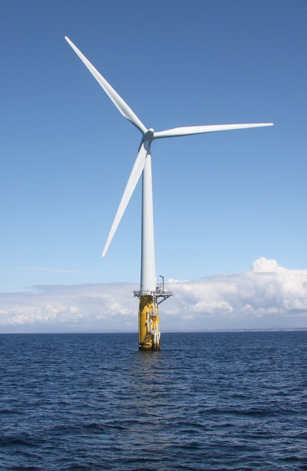
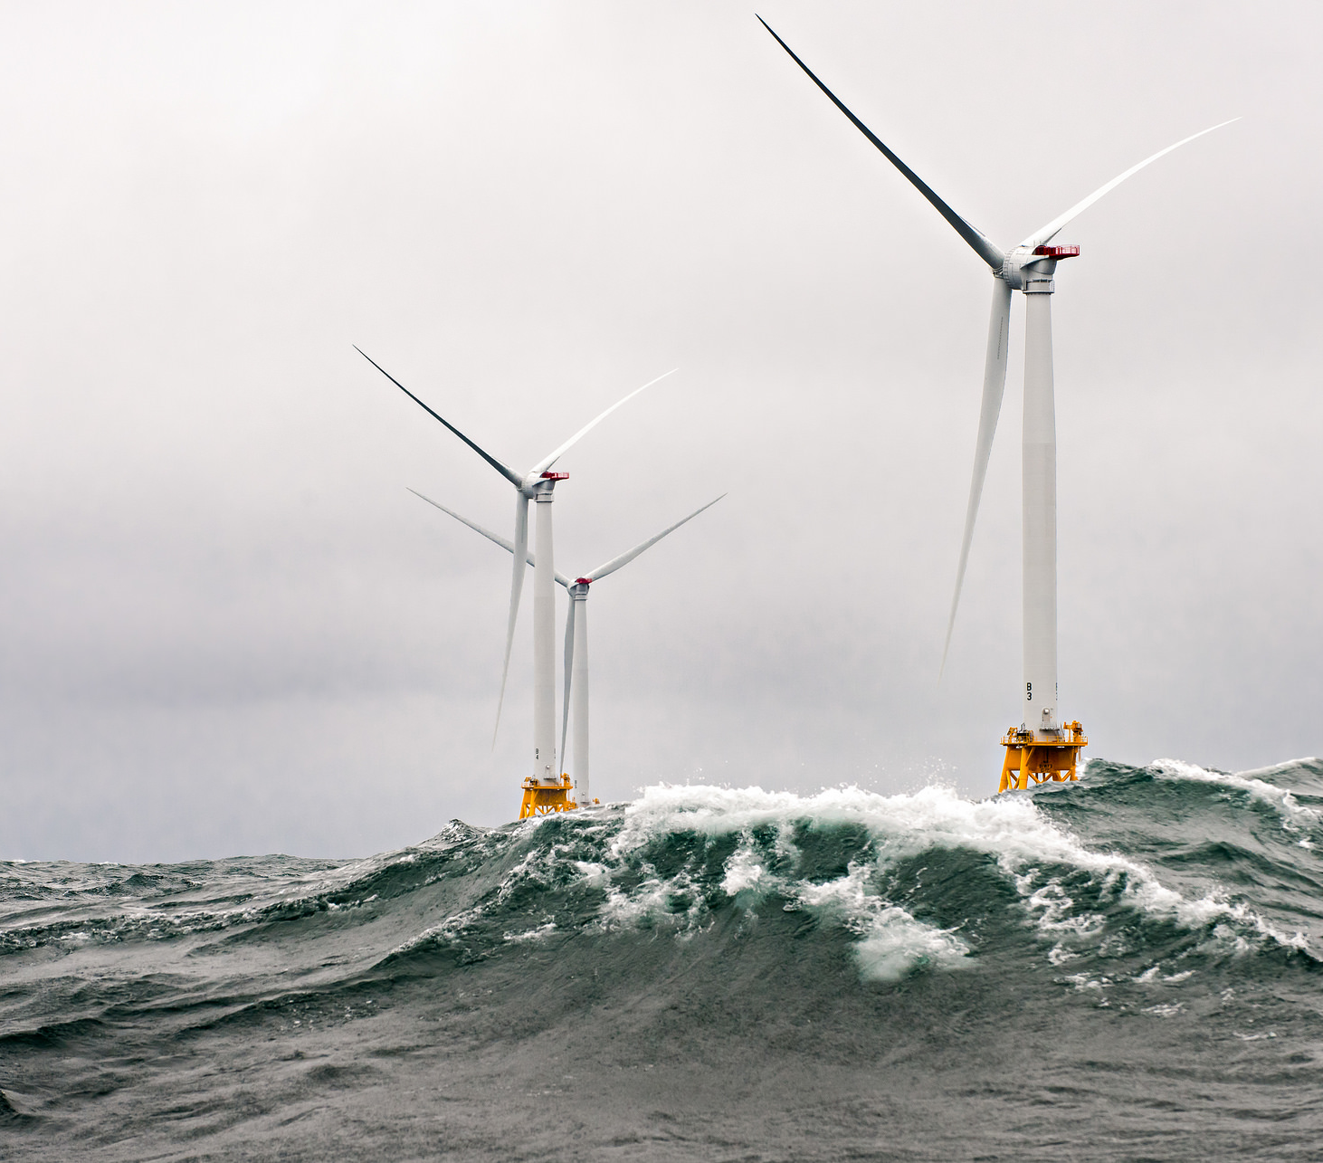
Introduction
Extreme Wave modelling:
  Focused Wave & Irregular Wave
  Why focused wave?
Studies on:
  Hywind Spar floater
  Wave tank test & CFD modelling
A photo of Statoil’s
Hywind Spar FOWT
A photo of FOWT survives in huge waves

Slide 3
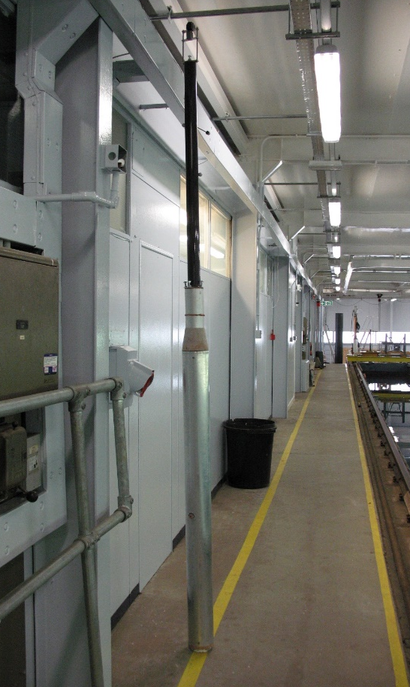
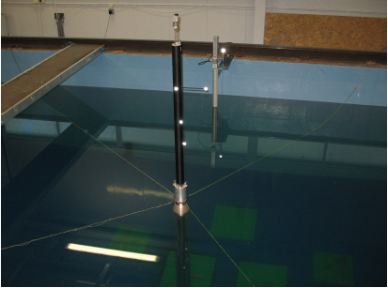
Experimental Setup (Structural Properties)
 | NREL OC3 Hywind[1] | Present model at KHL
Scaled Model | Prototype | Yes
Scaled Factor | N/A | 1:74
Platform Mass, including ballast | 7,466,330 kg | 19.916 kg (Tower included)
CM location below SWL | -89.9155 m | -1.0924 m
Platform Roll inertia | 4,229,230,000 kg*m² | 11.284 kg*m²
Platform Pitch inertia | 4,229,230,000 kg*m² | 11.284 kg*m²
Platform Yaw inertia | 164,230,000 kg*m² | N/A
Natural Frequency | Heave: 27.5s Pitch: 23.9s | Heave: 3.83(33.0)s Pitch: 3.60(31.0)s
Mooring Lines settings | 3 catenary lines | 4 soft mooring lines
A photo of the scaled (1:74)
spar model in KHL (Present)
1. Jonkman, J., 2010, "Definition of the Floating System for Phase IV of OC3," National Renewable Energy Lab.(NREL), Golden, CO (United States).
32 Duan, F., Hu, Z., and Niedzwecki, J. M., 2016, "Model test investigation of a spar floating wind turbine," Marine Structures, 49, pp. 76-96.

Slide 4
Experimental Setup (Loading Cases)
Test Metrix:
  Free Decay Tests
  Wave Excitation: Regular, Focused, Irregular (Interests)
    JONSWAP spectrum with identical wave peak period

Slide 5
WaveTank Data analysis (Pitch Motions)
FW001
Low Pass Filtering Cuttoff Freq. : 4Hz
Focused Wave:
  Free Decay motions after Tf
Irregular Wave:
  Stochastic phenomenon
IW001

Slide 6
WaveTank Data analysis (FW001)
Time Domain
Frequency Domain (PSDs)
Very Low frequency range
Wavelet analysis^{[2]}
Pitch natural frequency
Wave peak period
6
[2] Lin, E.-B., and Liu, P. C., 2004, "A discrete wavelet analysis of freak waves in the ocean," Journal of Applied Mathematics, 2004(5), pp. 379-394.

Slide 7
WaveTank Data analysis (Pitch PSDs)
Focused/Irregular waves
Same elapsed time selection: 200s
Nonlinear effect observed near second-order difference frequency
7

Slide 8
WaveTank Data analysis (RAOs)
Obtained from FW001/IW001
Agreed well near North sea wave periods(scaled) :0.4Hz < Freq. < 0.8Hz
Discrepancy of RAOs near platform natural frequency (viscous damping; wave-wave interaction)

Slide 9
CFD modelling (Methodology)
CFD solver “waveDyMFoam” in OpenFOAM^{[3][4]}
Wave generation: Toolbox “waves2Foam”
  Wave theory: First-order irregular waves
  Identical target wave spectrum to wave tank
Simulation cases:
  Focused waves (Code validation)
  Irregular waves not modelled
[3]Jacobsen, N.G., Fuhrman, D.R., Fredsøe; A wave generation toolbox for the open-source CFD library: OpenFoam® (2012) International Journal for Numerical Methods in Fluids, 70 (9), pp. 1073-1088.
[4] Zhou, Y., Xiao, Q., Liu, Y., Incecik, A., Peyrard, C., Li, S., and Pan, G., 2019, "Numerical modelling of dynamic responses of a floating offshore wind turbine subject to focused waves," Energies, 12(18), p. 3482.

Slide 10



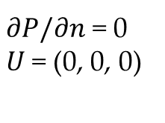
CFD settings (Boundary Conditions)
$∂P/∂n$ = 0, $∂U/∂n$ = 0
Wave Direction
Inlet
Y (Sway)
Outlet
$∂P/∂n$ = 0
Inlet Relaxation
Outlet Relaxation
$∂P/∂n$ = 0
$U$= (0, 0, 0)
X (Surge)
4.0m
$∂P/∂n$ = 0, $∂U/∂n$ = 0
6.0m
6.0 m
9.0m

Slide 11
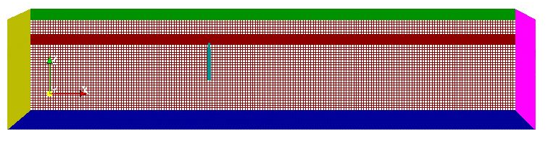
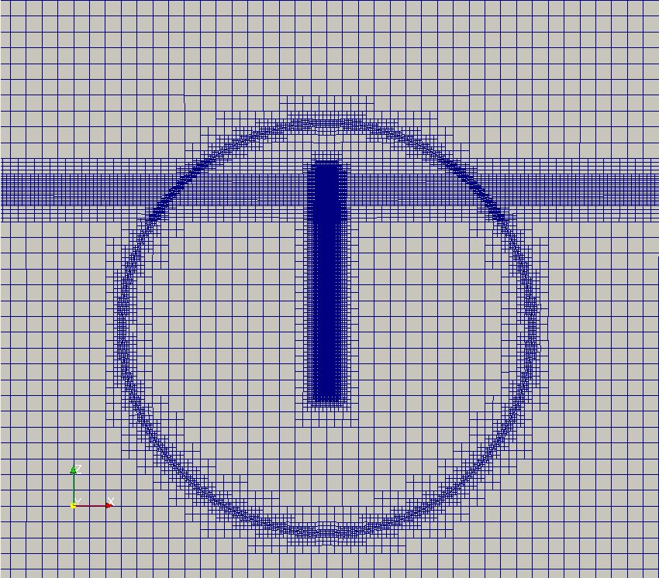
CFD settings (Computational Meshes)
Entire computational mesh
Mesh motion handling
  Built-in sliding mesh technique in OpenFOAM
Mesh size: 2.12 Million
Not allowed to translate on Surge
  To model 4 modified soft mooring lines
Mesh refinement near the free surface and the spar platform

Slide 12
Results (FW001, Motions)
Captured commendably between CFD and experimental
Discrepancy due to
  mooring lines modelling
  Wave-wave interaction

Slide 13
Results (FW001, PSDs)
Agreed well near incident wave energy range
Difference under floater natural frequency

Slide 14
Conclusions
Experimental: Compared between focused waves and Irregular waves RAOs
  Capture similar peak value in both wave types in time domain
  RAOs variance under floater natural frequency
CFD: Difference between CFD and wave tank data
  Mooring Line modelling: CFD (allow surge) Tank (soft mooring)
  Nonlinear loads calculation

Slide 15
Thank you for your attention!

Slide 16
Wavelet analysis (additional)
The traditional Fourier technique may not be suitable for non-stationary sequences^{[2]}, i.e., focused wave
Continuous wavelet transformation is applied to detect the time-frequency characteristics of the data under focused wave
Window function selection: Morlet wavelet
Time domain results selection: 80s-140s
[4] Lin, E.-B., and Liu, P. C., 2004, "A discrete wavelet analysis of freak waves in the ocean," Journal of Applied Mathematics, 2004(5), pp. 379-394.

