Slide 1
Preserving digital content through improved EPrints repository integration with Archivematica
George Macgregor ^{a,} ^{b}
ª Scholarly Publications & Research Data (SPRD), IS Information Management, University of Strathclyde
^{b} iSchool, Department of Computer & Information Sciences, University of Strathclyde
0000-0002-8482-3973 \\ @g3om4c
Tomasz Neugebauer ^{c}
^{c} Digital Projects & Systems Development Librarian, Concordia University
0000-0002-9743-5910 \\ @photomediathink

Slide 2
Background
Context:
EPrints, open source repository platform
Strathprints – implementation at University of Strathclyde
Different flavours = OA publication, data, OER
Plugin to enhance functionality (Bazaar)
Heterogeneous digital objects, e.g. text (PDF), video, etc.
Demands of the scholarly record: persistence, citability, accessibility, maintenance
Need for better digital preservation capacity among repositories needed through Archivematica interoperation
Concordia University spearheaded conceptual & development work, see [1] – support from EPrints Services & Artefactual & community
EPrints - Archivematica Integration @ GitHub: https://github.com/eprintsug/EPrintsArchivematica

Slide 3
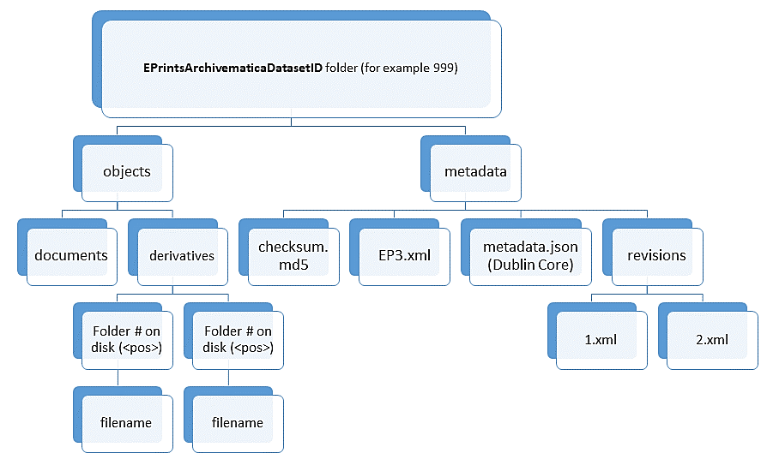
Digital preservation export: overview
@ the EPrints side…
Digital preservation export plugin
Config. files
Batch scripts (scheduled crons)
Identifies new/updated items worthy of preservation
process_transfers
‘Triggers’
Generates Archivematica optimized export of EPrints content using directory structure
Export includes rich repository metadata (XML, JSON, md5), digital objects (documents & derivatives)
Diagram: T. Neugebauer, EPrints - Archivematica Integration
@ GitHub: https://github.com/eprintsug/EPrintsArchivematica
@ the Archivematica side…
Exported content written to shared location
Archivematica automation tools used to pick up export at location & begin processing transfers within the Archivematica pipeline

Slide 4
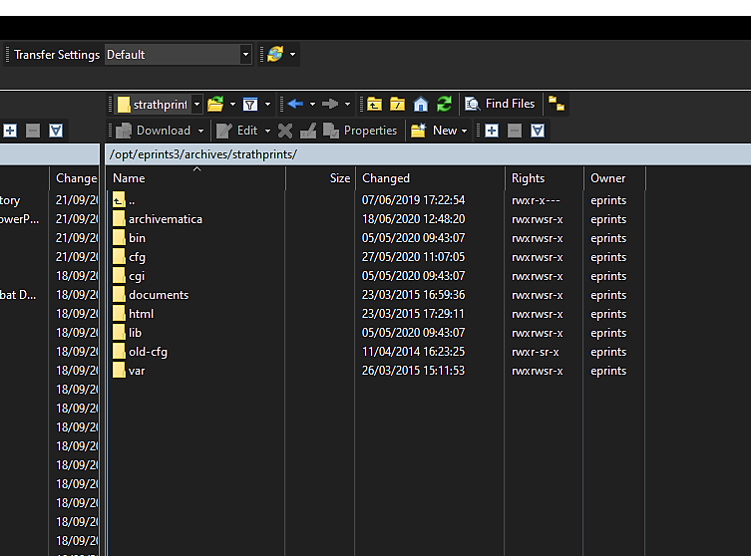
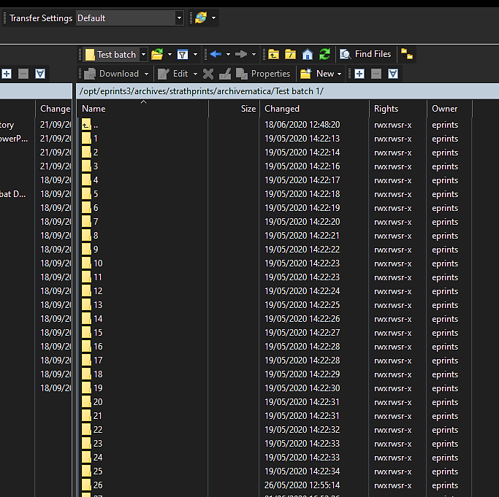
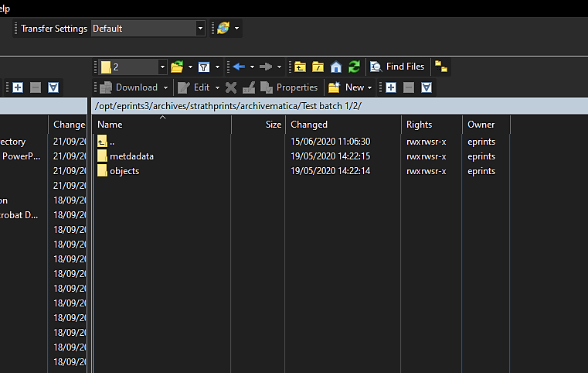
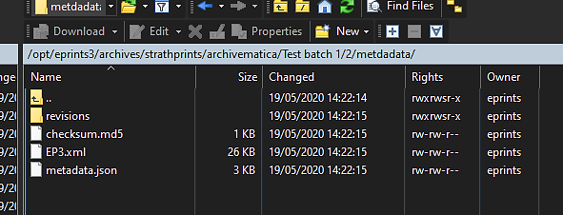
Export: abstraction to reality…
Generated EPrints export in Archivematica-friendly format…

Slide 5
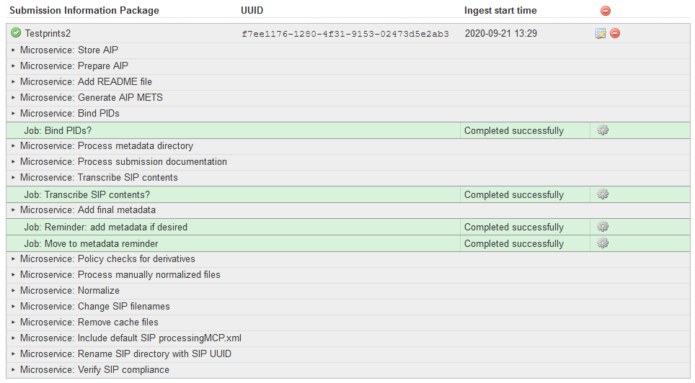
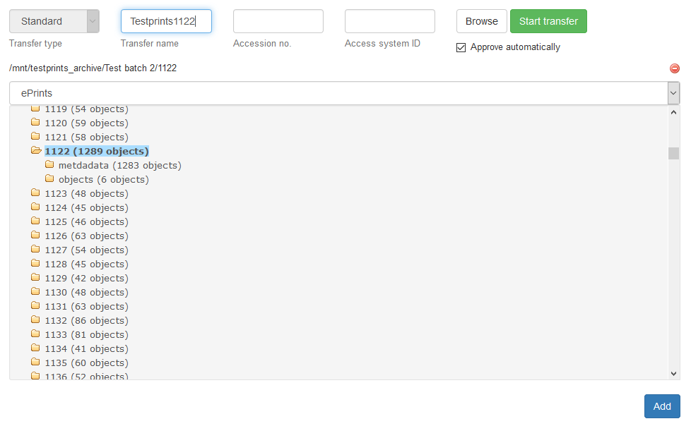
Anatomy of EPrints export ingest… (1)
Use case is for automation via export cron jobs @ Eprints side
With automation @ the Archivematica side
Useful to examine manually though…

Slide 6
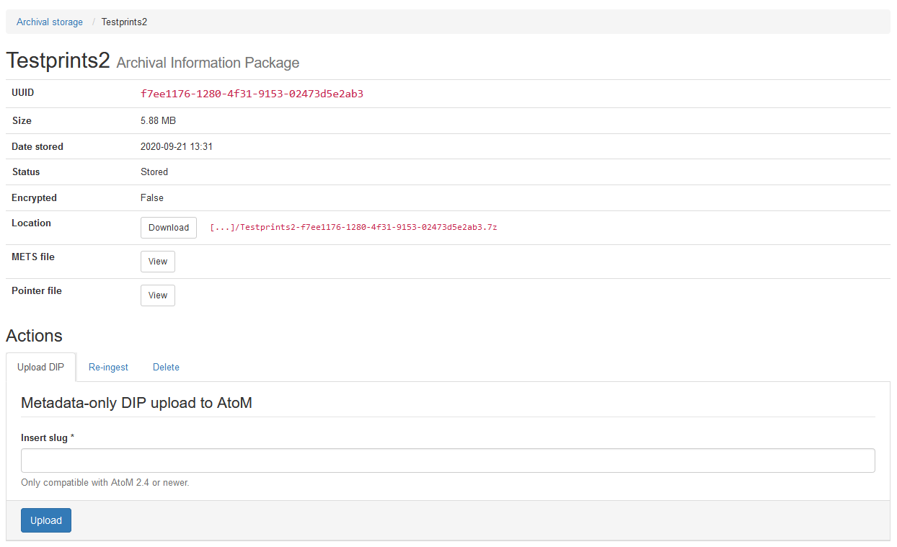
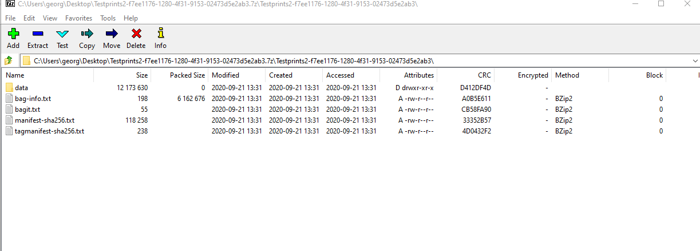
Anatomy of EPrints export ingest… (AIP)

Slide 7
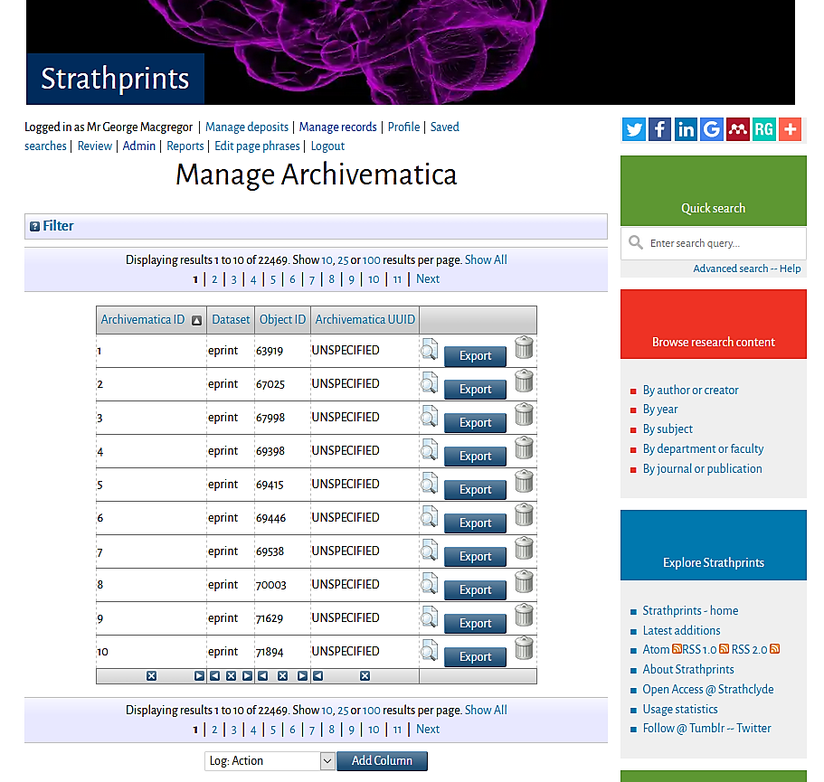
Repository dashboard management…
Preservation exports can be monitored and managed via EPrints dashboard, e.g.
Archivematica ID
Local ID
Archivematica UUID(?!)
Unspecified! ;-)
Work to be done:
RESTful endpoint supported by Eprints
API call back from Archivematica with UUID – coming soon!

Slide 8
Experimentation: results
Testing, testing, testing!
Currently experimenting in our test environment (circa 6 months)
Lots of KE with Concordia
Experimentation positive; minor niggles
Repositories interesting use case, involving large volume of content
Rolling out to production = autumn 2020!
Probable rollout without API call back
Repository ecosystem at Strathclyde: repository & Current Research Information System (CRIS) running in parallel
Compromise in data that can be written to Strathprints [2]
Possible hacks to make call back via write protection of EPrints DB fields (John Salter @ WRRO)

Slide 9
Other work to be done, or already done…
Call back… in hand
Improved metadata modelling in the JSON export
Additional export job options
touch_transfers: Updates all Archivematica records which are not pending a transfer
create_transfers: Create Archivematica records which do not already exist
Packaging as EPrints plugin & depositing in the EPrints Bazaar

Slide 10
References
[1] Neugebauer, Tomasz , Simpson, Justin and Bradley, Justin (2018) Digital Preservation through EPrints- Archivematica Integration. In: 13th International Conference on Open Repositories (OR2018), June 3-7, 2018, Bozeman, Montana, USA. Available: https://spectrum.library.concordia.ca/983933/
[2] Macgregor, George (2019) Repository and CRIS interoperability issues within a 'connector lite' environment. In: 14th International Conference on Open Repositories (OR2019), June 10-13, 2019, Universität Hamburg, Germany. Available: https://strathprints.strath.ac.uk/68240/

